Slide 1


GASB 87 : Understanding and Implementing the New Lease Accounting Standard
Thursday, February 4th, 2021

Slide 2
GASB Statement No. 87 Objectives
GASB 87 Defined
Understanding Departmental Responsibilities
Identifying GASB 87 Criteria
Completion of GASB 87 Questionnaire with Examples
Renewal Contracts
Process for Renewal PO’s
Identifying LEASE ID Number
What is happening at each level of this process?
Other Items
Rental Contracts – How are these different?
Implementation Date – When do we start?
Resource Site – Where can I find information and forms?
Lease ID Number Naming Convention – What does the number identify?
New Lease Contracts

Slide 3
GASB 87 Defined
Why Change?

Slide 4
Why is the reporting for Leases Changing:
Currently, there are two separate types of leases.
  "Capital Leases" are those leases that meet certain criteria as set forth in FASB Statement No. 13. These leases are recorded on the financial statements as an asset (for the underlying item being leased) and a lease liability (for the remaining future lease payments).
  "Operating Leases" are all leases that don't meet the criteria of FASB 13. These leases do not report any debt for future outflows of resources that may be required. Instead, the payments for these leases are recorded as expenditure in the year paid and no asset is recorded for the underlying item being leased.
The concern that GASB had with the current presentation is the financial statements do not reflect the debt outstanding on “Operating” leases and this could result in incorrect assumptions being made by the users of the financial statements related to cash solvency of the governmental entity.

Slide 5
How are Leases Changing?
GASB Statement No. 87 establishes a single reporting model for lease accounting to enhance the relevance and consistency of information about governments' leasing activity. GASB 87 changes the definition of a lease to eliminate the "capital" and "operating" differences.
All leases meeting GASB 87 criteria require Lessees to recognize a lease liability and intangible right-to-use lease asset and Lessors to recognize a lease receivable and a deferred inflow of resources.

Slide 6
GASB 87 Standard
GASB 87 states, "A lease is defined as a contract that conveys control of the right to use another entity’s nonfinancial asset (the underlying asset) as specified in the contract for a period of time in an exchange or exchange-like transaction. Examples of nonfinancial assets include buildings, land, vehicles, and equipment. Any contract that meets this definition should be accounted for under the leases guidance, unless specifically excluded in this Statement."

Slide 7
GASB 87
New Lease Contracts

Slide 8
Procedures
New Lease Contracts
Complete Purchase Requisition in accordance with normal purchasing procedures – NO CHANGE
Leases with terms greater than 12 months will require completion of the GASB 87 Questionnaire.

Slide 9
GASB 87 Questionnaire

Slide 10
GASB 87 Questionnaire
New Lease Contracts
Steps preparer through the GASB 87 determination process:
Two Determinations:
  Not GASB 87 - Document reason for being excluded and STOP. Attach form to Purchase Requisition
  GASB 87 Eligible – Continue to answer questions and follow instructions for the type of lease that will be booked. Attach form to Purchase Requisition.
Required to document that UGA considered GASB 87 Criteria. Provides audit evidence.

Slide 11
GASB 87 Questionnaire
Example #1 – NOT GASB 87
Lease DOES NOT Meet GASB 87 Criteria

Slide 12
GASB 87 Questionnaire – NOT GASB 87
Lease DOES NOT MEET GASB 87 Criteria
Notice that the first three questions drive the determination of whether or not a lease meets GASB 87 criteria.
IF EXCLUDED by GASB 87
OR
Term of Lease 12 months or LESS

Slide 13
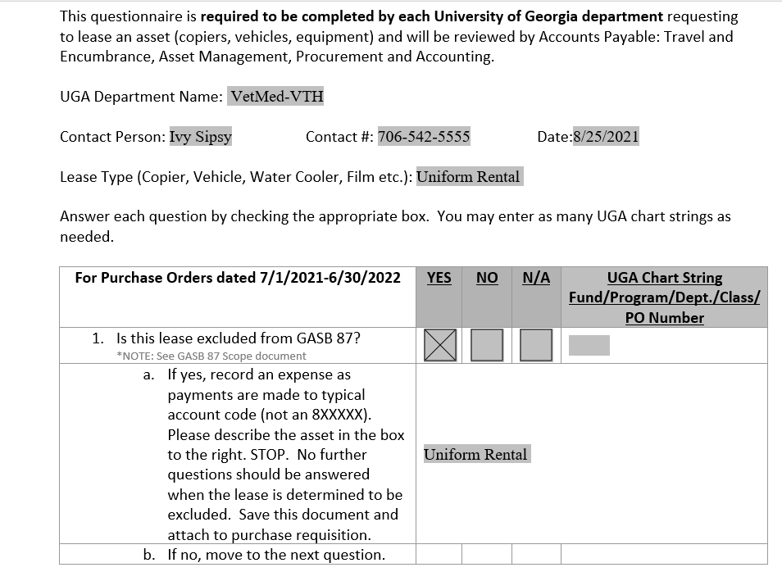
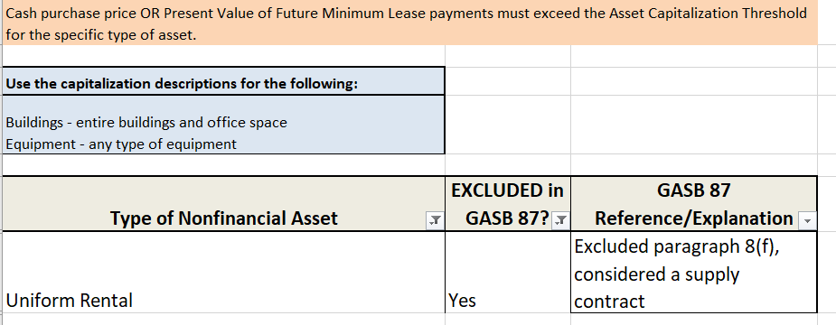
EXAMPLE 1:
Uniform Rental (Requisition Number 120291774)
Complete the GASB 87 Questionnaire
GASB 87 Scope Document
Lease DOES NOT MEET GASB 87 Criteria, you can stop at this point.

Slide 14
GASB 87 Questionnaire
Example #2 - INSIGNIFICANT
Lease Meets GASB 87 Criteria but the Fair Value or Purchase Price is less than the Capitalization Threshold.

Slide 15
GASB 87 Questionnaire – GASB 87 Insignificant
Lease MEETS GASB 87 Criteria but is INSIGNIFICANT
Notice that the ONLY question that drives this determination is whether or not a lease meets the Material Dollar Threshold:
Is the Cash purchase price > Capitalization Threshold?

Slide 16
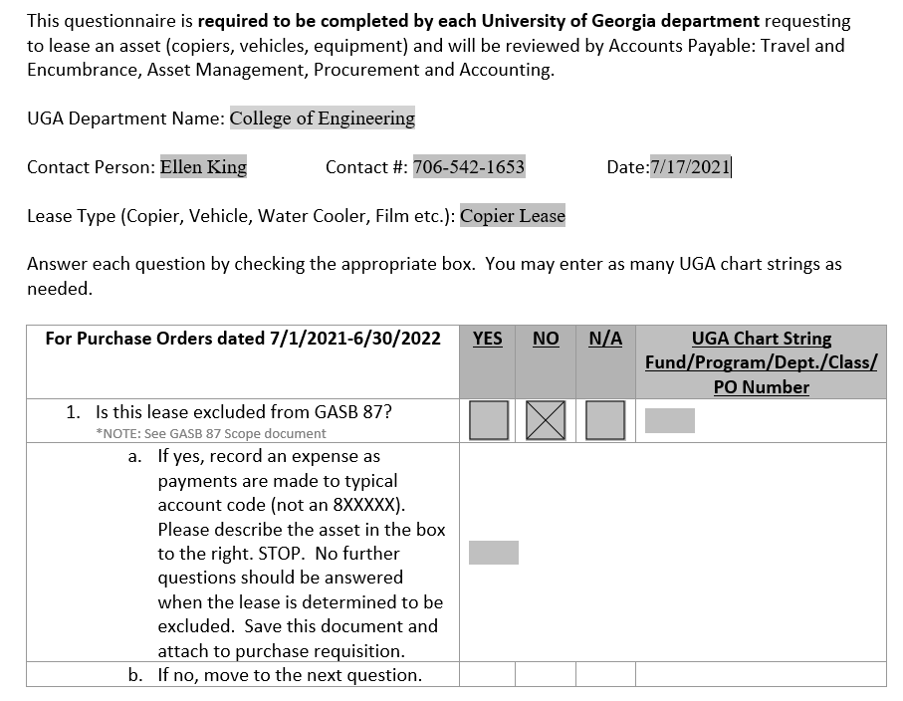
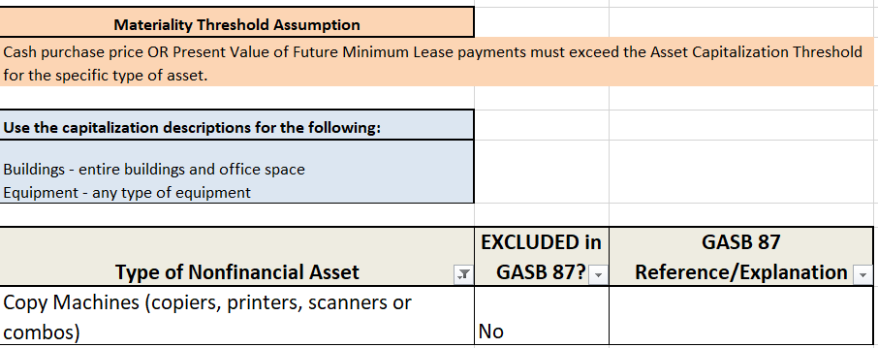
EXAMPLE 2:
Copier Lease (Requisition Number 133868643)
Complete the GASB 87 Questionnaire
GASB 87 Scope Document

Slide 17
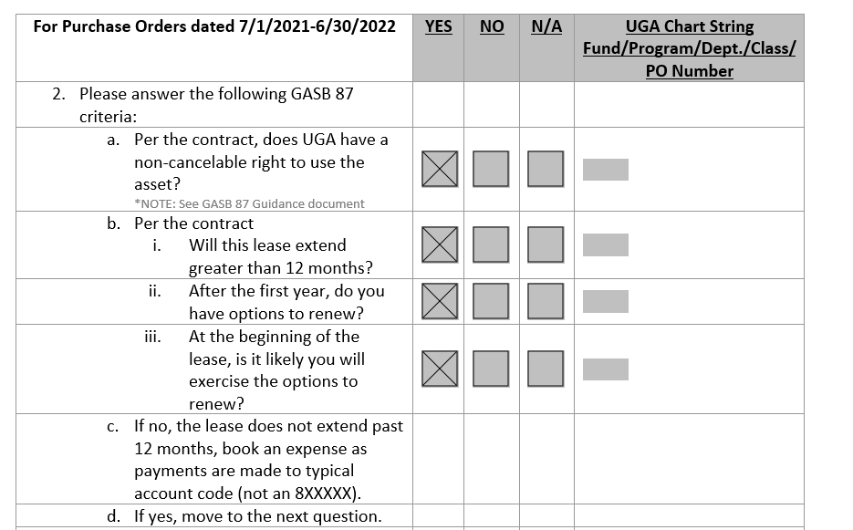

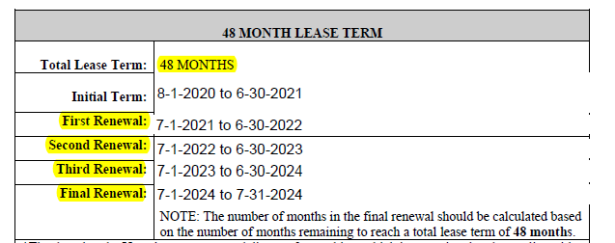
EXAMPLE 2:
Copier Lease (Requisition Number 133868643)
Complete the GASB 87 Questionnaire
Review the Lease Agreement
NOTE for 2biii: It is UGA's policy that it is reasonably certain that renewal options will be exercised for all renewal periods allowed in the contract.

Slide 18
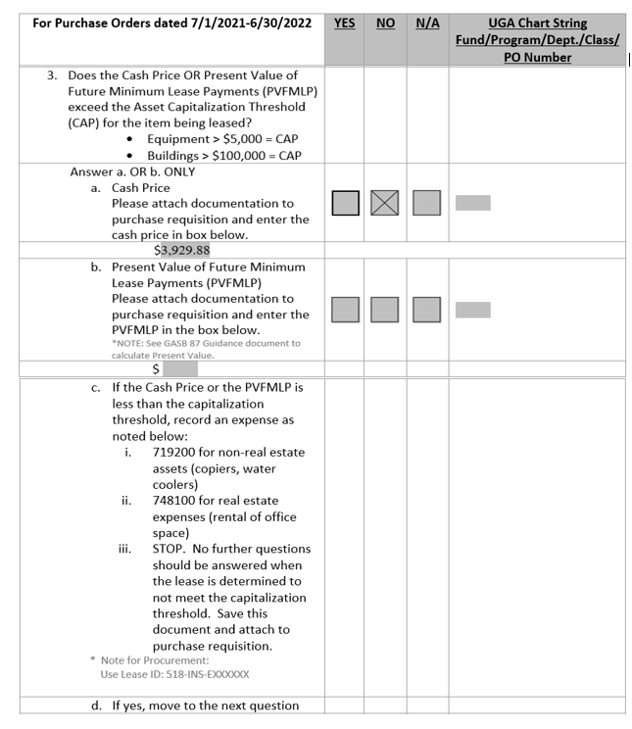
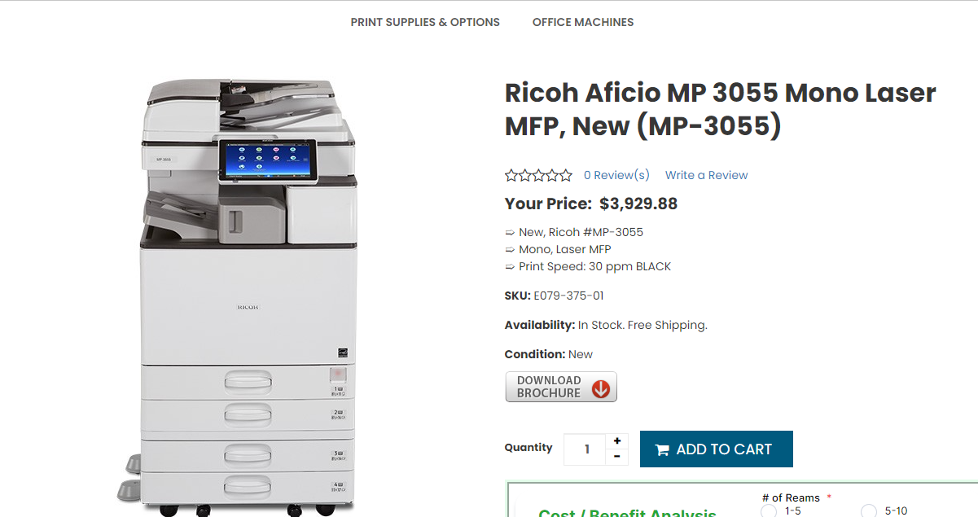

EXAMPLE 2:
Copier Lease (Requisition Number 133868643)
Complete the GASB 87 Questionnaire
Cash Price Determination
Lease MEETS GASB 87 Criteria but is INSIGNIFICANT, you can stop at this point.
NOTE for 3a: Obtain the "CASH" price of the item that you want to lease is before you initiate the purchase request for the lease. If possible, take a screen shot of the cash price quoted or print the page and scan it into the purchase request document.

Slide 19
GASB 87 Questionnaire
Example #3 – GASB 87 LEASE
Lease Meets GASB 87 Criteria – LEASED ASSET

Slide 20
GASB 87 Questionnaire – GASB 87 Lease
Lease MEETS GASB 87 Criteria
Notice that ALL questions must be answered according to the chart at right for a lease to meet the GASB 87 criteria.

Slide 21
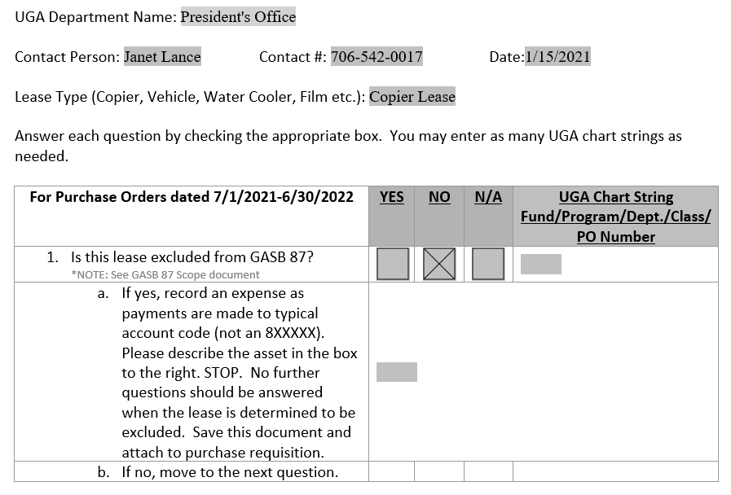
EXAMPLE 3:
Copier Lease (Requisition Number 137367192)
Complete the GASB 87 Questionnaire
GASB 87 Scope Document
9/03/2021

Slide 22
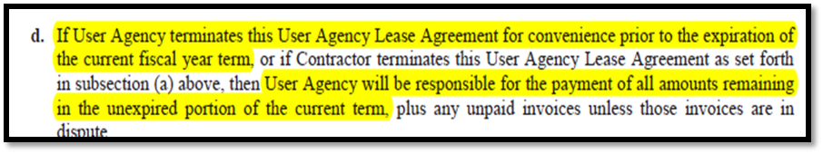
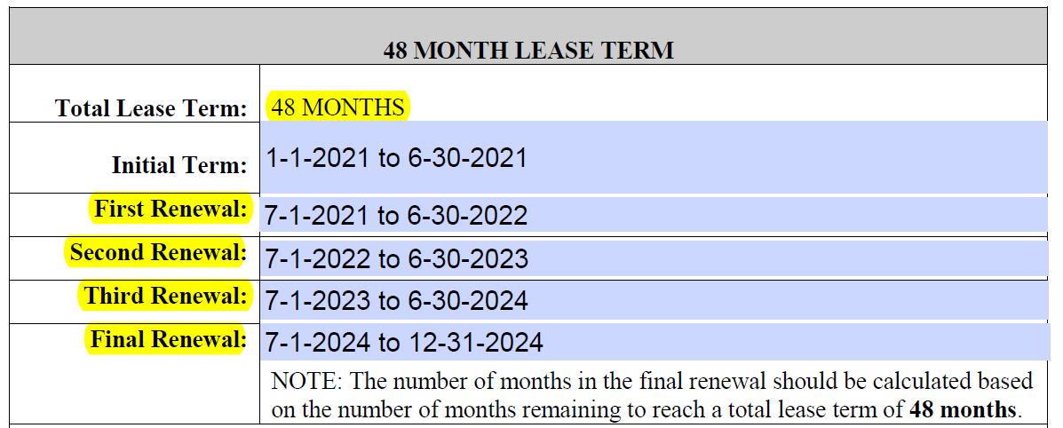
EXAMPLE 3:
Copier Lease (Requisition Number 137367192)
Complete the GASB 87 Questionnaire
Review the Lease Agreement
NOTE for 2biii: It is UGA's policy that it is reasonably certain that renewal options will be exercised for all renewal periods allowed in the contract.

Slide 23
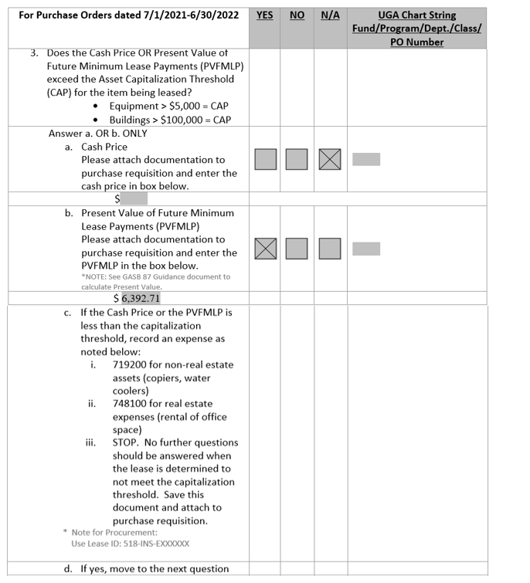
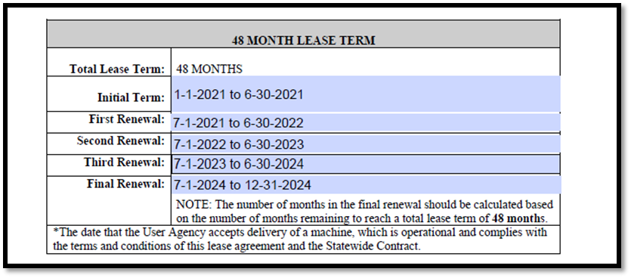
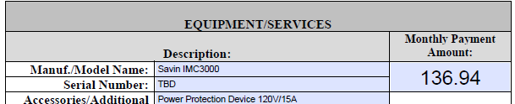
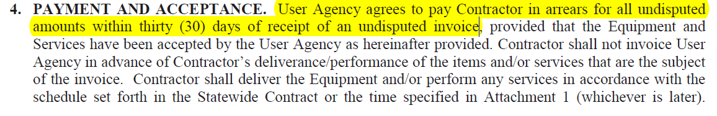
EXAMPLE 3:
Copier Lease (Requisition Number 137367192)
Complete the GASB 87 Questionnaire
Present Value of Future Minimum Lease Payments:
GASB 87 Guidance Document
Review the Lease Agreement

Slide 24
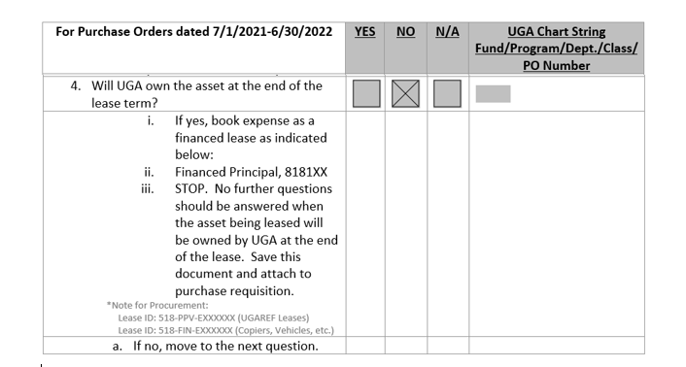
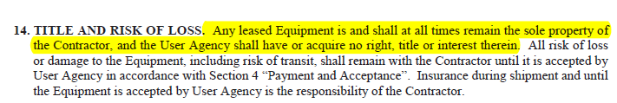
EXAMPLE 3:
Copier Lease (Requisition Number 137367192)
Complete the GASB 87 Questionnaire
Review the Lease Agreement

Slide 25
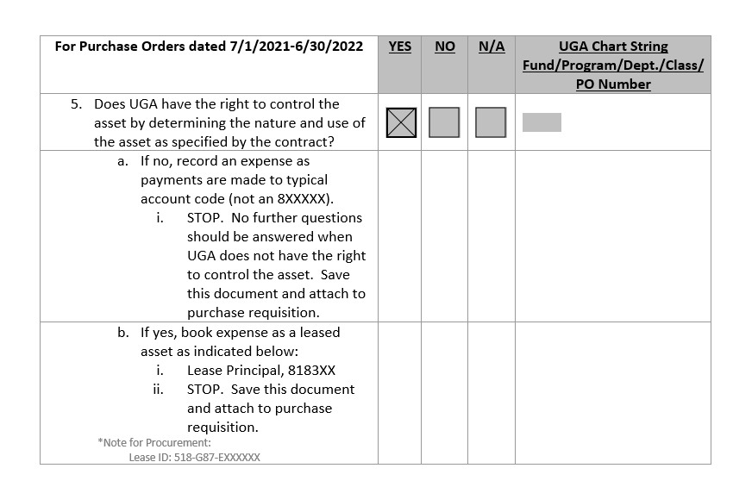
EXAMPLE 3:
Copier Lease (Requisition Number 137367192)
Complete the GASB 87 Questionnaire
Does UGA have access to use the item? YES
Does the vendor place limitations on what you can do with the leased asset? NO
Lease MEETS GASB 87 Criteria

Slide 26
GASB 87 Questionnaire
Example #4 – FINANCED PURCHASE
Lease Meets GASB 87 Criteria – Asset OWNED by UGA

Slide 27
GASB 87 Questionnaire – Financed Purchase
Lease MEETS GASB 87 Criteria for Financed Lease
Notice that the ONLY question that drives this determination is whether or not UGA will own the asset at the end of the lease.

Slide 28
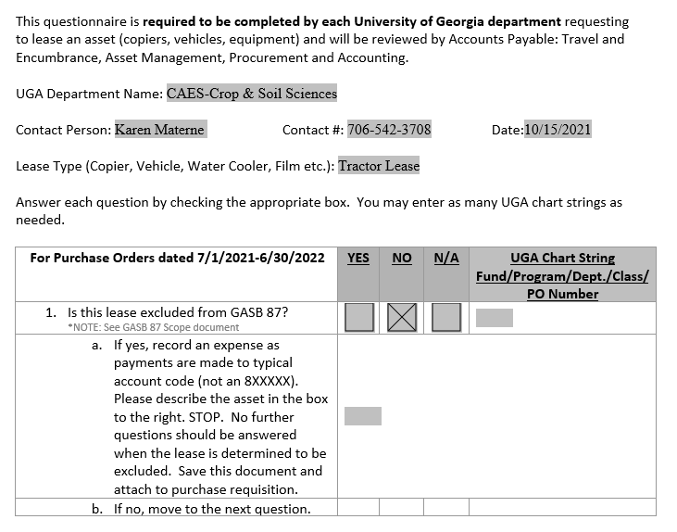
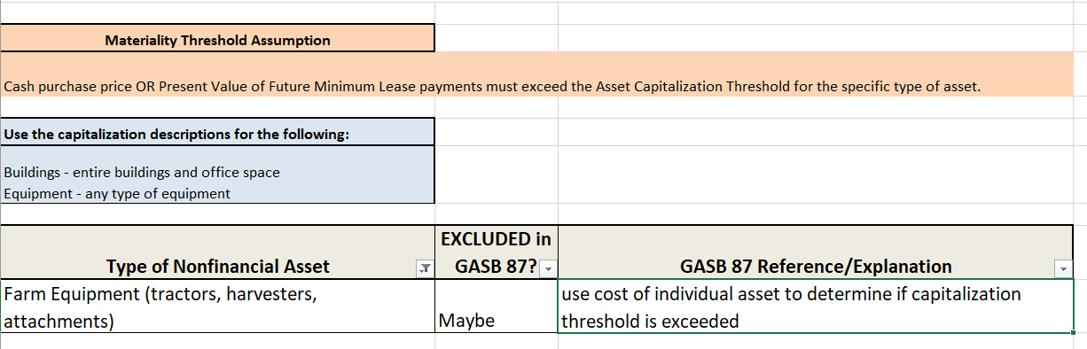
EXAMPLE 4:
Farm Equipment Lease (Requisition Number 82314440)
Complete the GASB 87 Questionnaire
GASB 87 Scope Document

Slide 29
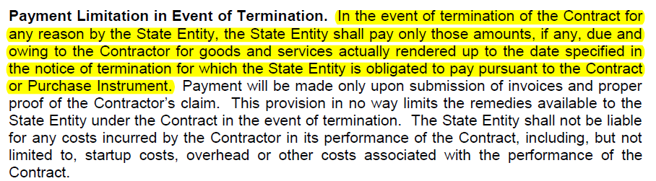
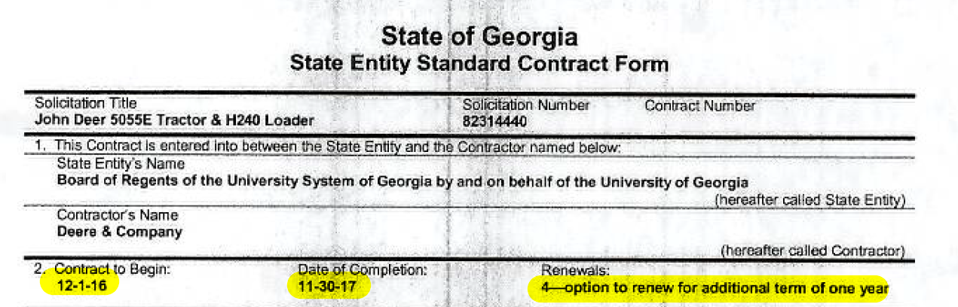
EXAMPLE 4:
Farm Equipment Lease (Requisition Number 82314440)
Complete the GASB 87 Questionnaire
Review the Lease Agreement
NOTE for 2biii: It is UGA's policy that it is reasonably certain that renewal options will be exercised for all renewal periods allowed in the contract.

Slide 30
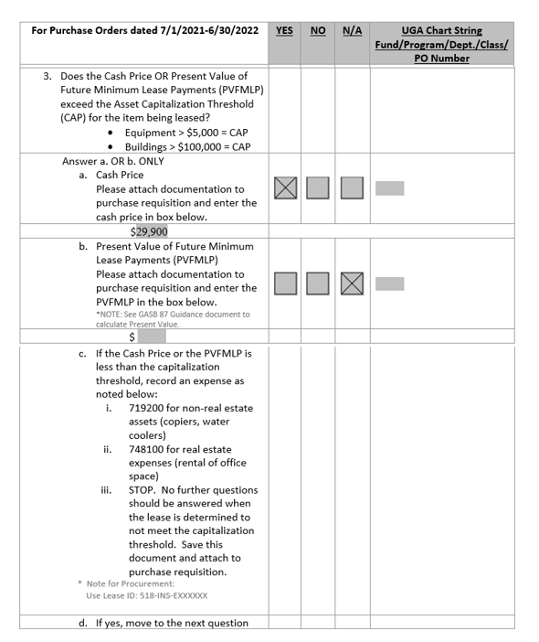
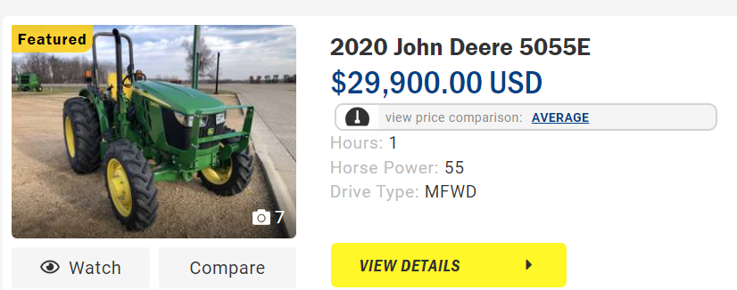
EXAMPLE 4:
Farm Equipment Lease (Requisition Number 82314440)
Complete the GASB 87 Questionnaire
Cash Price Determination
NOTE for 3a: Obtain the "CASH" price of the item that you want to lease is before you initiate the purchase request for the lease. If possible, take a screen shot of the cash price quoted or print the page and scan it into the purchase request document.

Slide 31
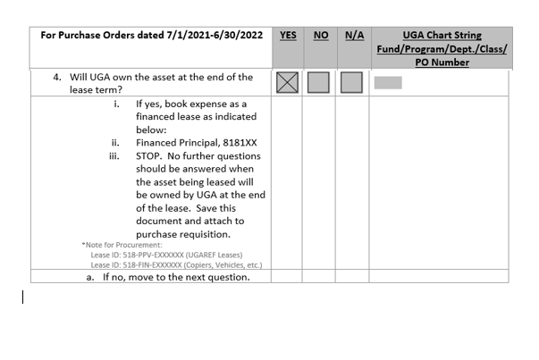
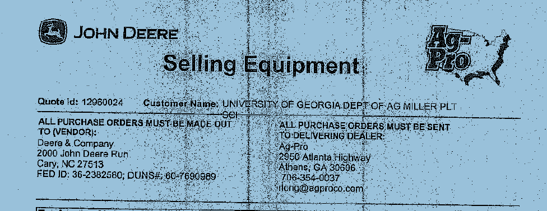
EXAMPLE 4:
Farm Equipment Lease (Requisition Number 82314440)
Complete the GASB 87 Questionnaire
Review the Lease Agreement

Slide 32
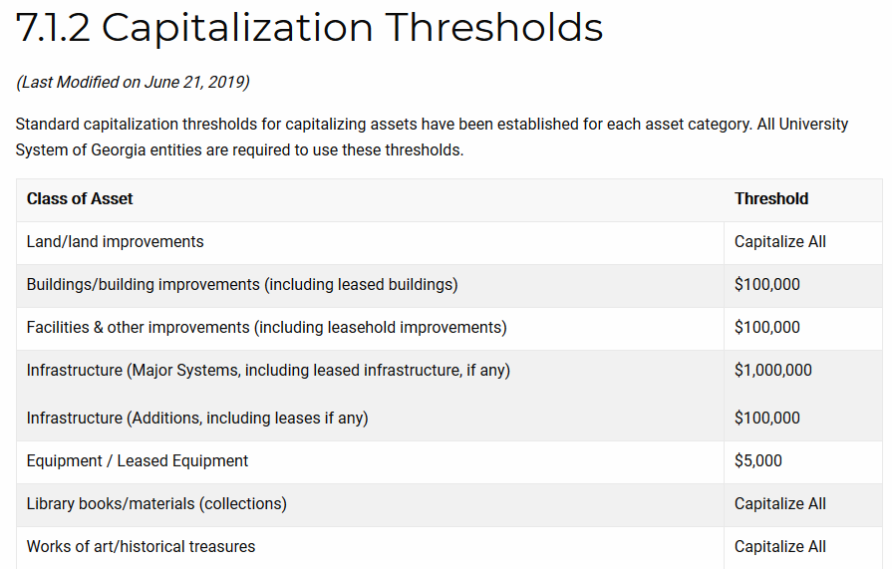
USG 7.1.2 Capitalization Thresholds

Slide 33
GASB 87
Renewals Contracts
Each year that a lease is renewed, a new PO for that budget year will be completed.

Slide 34
Procedures
Lease Renewal Contracts
Complete Purchase Requisition in accordance with normal purchasing procedures – NO CHANGE
Lease Renewals will REQUIRE referencing/including the initial PO number AND Lease ID Number on ALL subsequent year’s Requisitions and Purchase Order documents .
  Multi-year leases will be tracked as one lease throughout the various years of PO’s that are required by budgeting limitations.
Listing will be provided to Campus in Late February 2021.

Slide 35
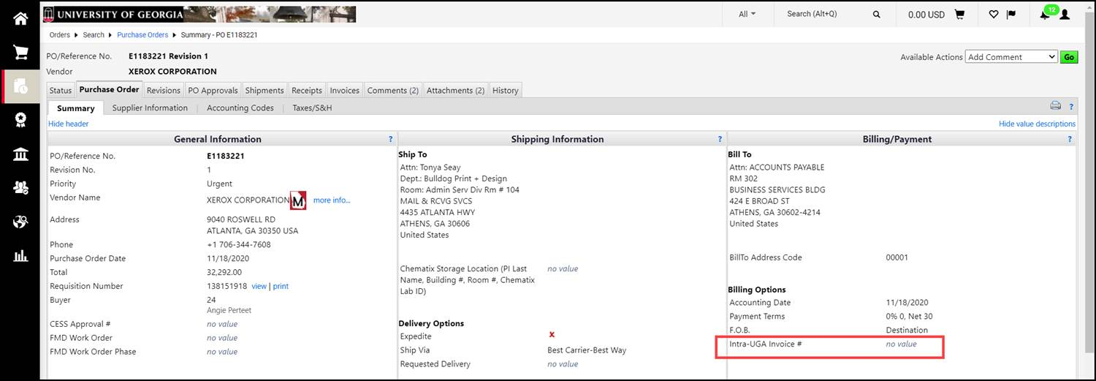
Location of Lease ID Number
Purchase Order – Initial (First Year of Lease Contract)
FIND Lease ID Number Here:

Slide 36
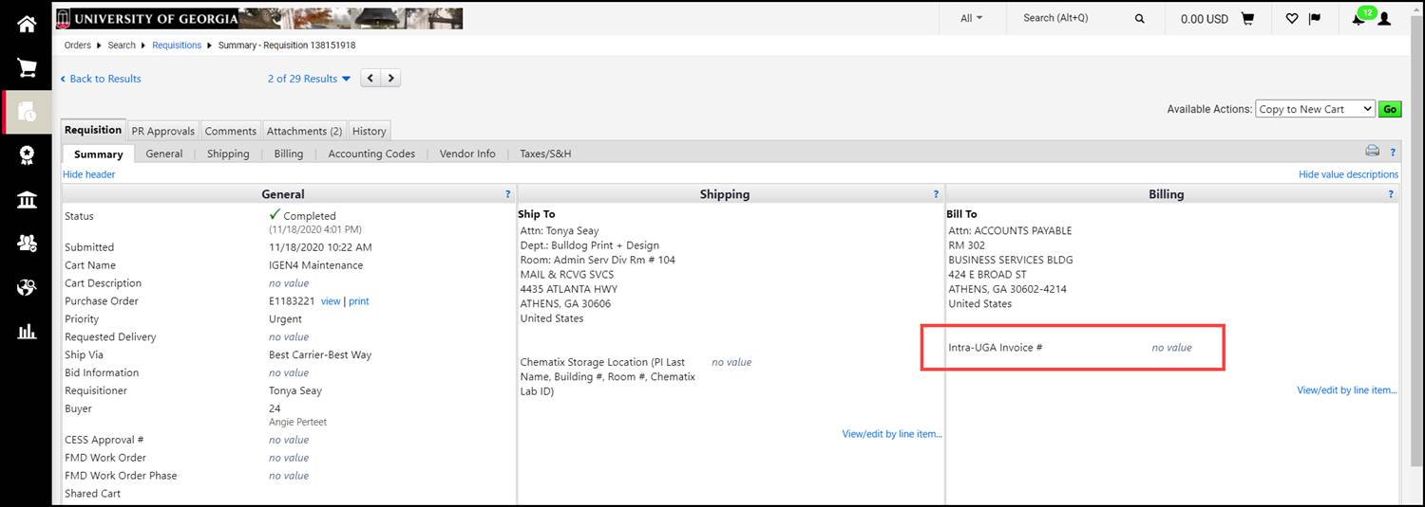
Location of Lease ID Number
Purchase Requisition – Where to Add the Lease ID Number
ADD Lease ID Number Here:

Slide 37
GASB 87 Department Workflow Approval Process
Department Responsibility
Identification of how this Process flows from initiation of requisition to identification in General Ledger.

Slide 38
GASB 87 Department Workflow Approval
Department Level:
Initiator:
  Create Purchase Requisition in accordance with normal purchasing procedures
  Complete GASB 87 Questionnaire
Approver:
  Review Purchase Requisition in accordance with normal purchasing procedures
  Review GASB 87 Questionnaire. Compare to Requisition for any mismatched information.
Once approved through department workflow, the requisition will flow to Accounts Payable

Slide 39
GASB 87 Department Workflow Approval
Accounts Payable Level:
Review and compare GASB 87 Questionnaire and Requisition for GASB 87 determination.
  If GASB 87 Questionnaire NOT ATTACHED – Requisition will be returned to Department for completion
  For COMPLETED GASB 87 Questionnaire ATTACHED - INFO DOESN’T MATCH – Requisition will be returned to Department for correction of info on Requisition and GASB 87 Questionnaire
    INFO CORRECT - Determine correctness of Expense Account Code used on Requisition based on questionnaire answers
      This may result in the Requisition Expense Account Code being changed
Once approved through department workflow, the requisition will flow to Asset Management.

Slide 40
GASB 87 Department Workflow Approval
Asset Management Level:
Review and compare GASB 87 Questionnaire and Requisition for GASB 87 determination. Determine appropriateness of Expense Account Code
  If Account Code is not correct – Requisition will be returned to Department for completion
Enter Asset Profile for the lease – completion of the asset profile will remain as pending until the first invoice is received from the vendor
Once approved through department workflow, the requisition will flow to Procurement.

Slide 41
GASB 87 Department Workflow Approval
Procurement Level:
Review and compare GASB 87 Questionnaire and Requisition for GASB 87 determination.
  If Requisition doesn’t agree with Questionnaire related to various GASB 87 criteria, the Requisition will be returned to Department for correction
Finalize Requisition and create Contract(s) for Leases Assets
Create the Purchase Order
  Add Lease ID Number to PO
Attach Contract to PO

Slide 42
GASB 87 Department Workflow Approval
Asset Management Level:
First Invoice from Vendor –
  Review and compare payment information to contract that is created by Procurement and Requisition
    Department will be contacted for any variances between contract and invoice (1st payment date, amounts billed, etc.)
    Ensure that Leased Asset has been delivered on site by vendor
Add Asset in Asset Management System
  Lease data will be added and an amortization schedule will be created.
  Prepare an inventory tag for distribution to department for inventory purposes

Slide 43
GASB 87 Department Workflow Approval
Accounting Level:
Monitor and verify that the Leased Asset is on campus via the annual inventory check
Monitor payments based on Lease ID Number through various queries (GL and AM queries)
Compare AM Module to AP Module (UGA Mart)
  Prepare year end entries to adjust year end liability/expense activity
  Reconcile Debt Outstanding
  Prepare Capital Asset and Long-Term Debt Notes based on info in Actuals, GAAP and Capital

Slide 44
GASB 87
Other Items

Slide 45
Procedures
New Rental Contracts
Complete Payment Request in accordance with normal purchasing procedures (rentals less than 90 days/ 3 months)
Payment Requests would not meet the greater than 12 month requirement and would not be required to complete the questionnaire.
UGA Policy 4.9 Rentals and Leases

Slide 46
Implementation Schedule
March 1, 2021 - Departments should start using the GASB 87 Questionnaire for ALL NEW LEASES. Attachment of questionnaire will be REQUIRED. Renewals of current leases will require a LEASE ID Number that has been created. (ALL Departments and Central Departments)
  List of LEASE ID Numbers will be made available to Departments prior to March 1, 2021. We are creating/updating these numbers and will have them available the last week of February 2021.
March 31,2021 - Board of Regents has required that ALL current leases meeting GASB 87 criteria are to be entered into AM Module (AM and Accounting)
July 1, 2021 – GASB 87 Reporting Requirements will become effective. All transactions should reflect LEASE ID Numbers (ALL Departments and Central Departments)

Slide 47
LEASE ID Number Naming Convention
Lease DOES NOT MEET GASB 87 Criteria – NO LEASE ID NUMBER
Lease MEETS GASB 87 Criteria – All Leases in these categories will need to be tracked with these numbers going forward:
  Insignificant - Purchase Price < Capitalization Threshold – “518-INS-Exxxxxx”
  Meets GASB 87 Criteria – Purchase Order System – “518-G87-Exxxxxx”
  Meets GASB 87 Criteria – Building Space lease through UGA Real Estate Office – “518-G87-REvin#-YYYY”
  Financed Purchase - UGA owns or will own asset – “518-FIN-Exxxxxx”
  Buildings financed through UGA RE Foundation – “518-PPV-Exxxxxx”

Slide 48
Accounting GASB Pronouncements Webpage
A new website page is being created THIS WEEK to provide a one-stop-shop for all things GASB 87. Will have more details in February 11, 2021 Breakout Session
Departments will be able to download the following:
  GASB 87 Questionnaires required to be attached to Requisitions
  GASB 87 Scope – document to identify GASB 87 Exclusions
  GASB 87 Guidance – Step-by-step assistance with completion of questionnaire and other helpful information.
  THIS PRESENTATION – PowerPoint or Webinar Presentation???
  Link to actual pronouncement as written by the Governmental Accountings Standards Board (GASB)
New SITE

Slide 49
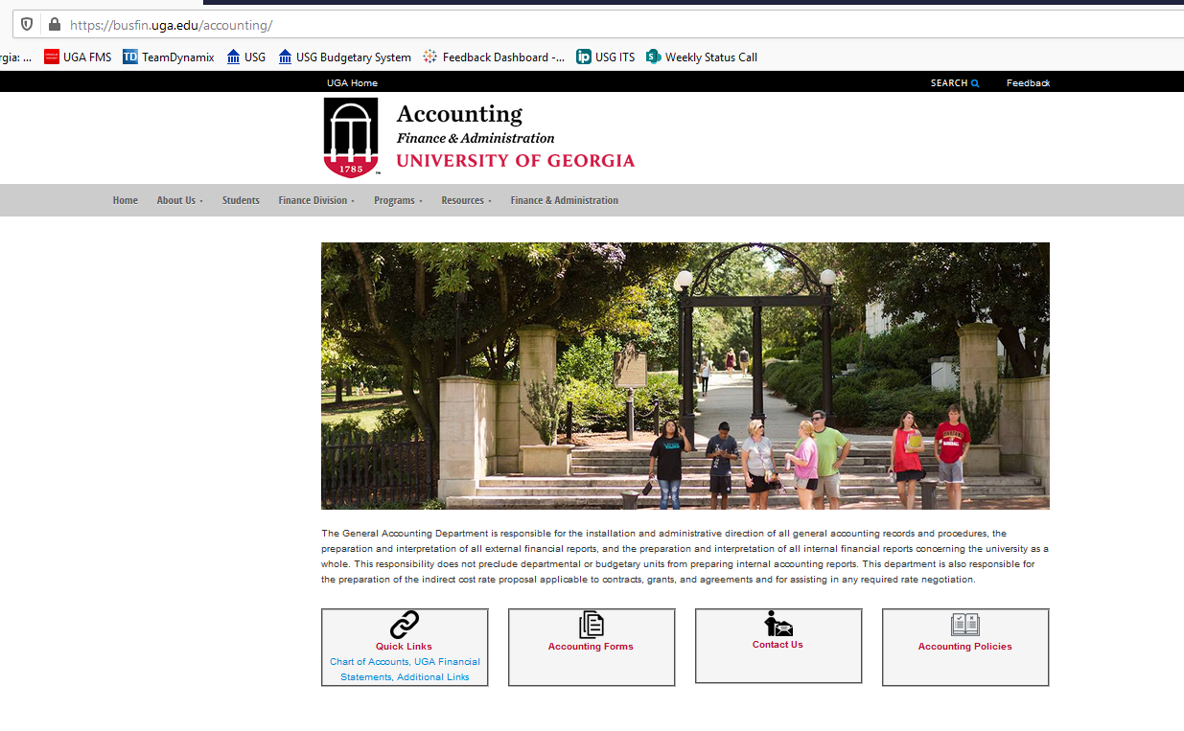
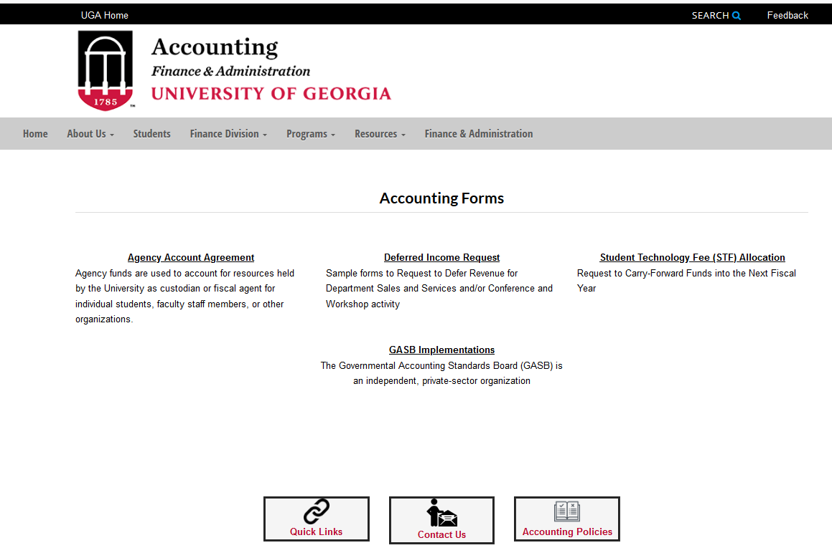
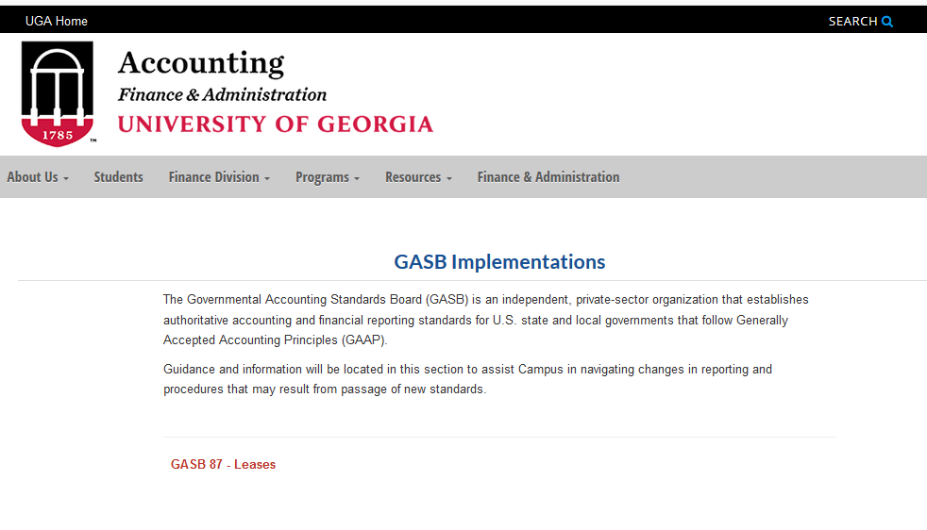
Accounting GASB Pronouncements Webpage

Slide 50
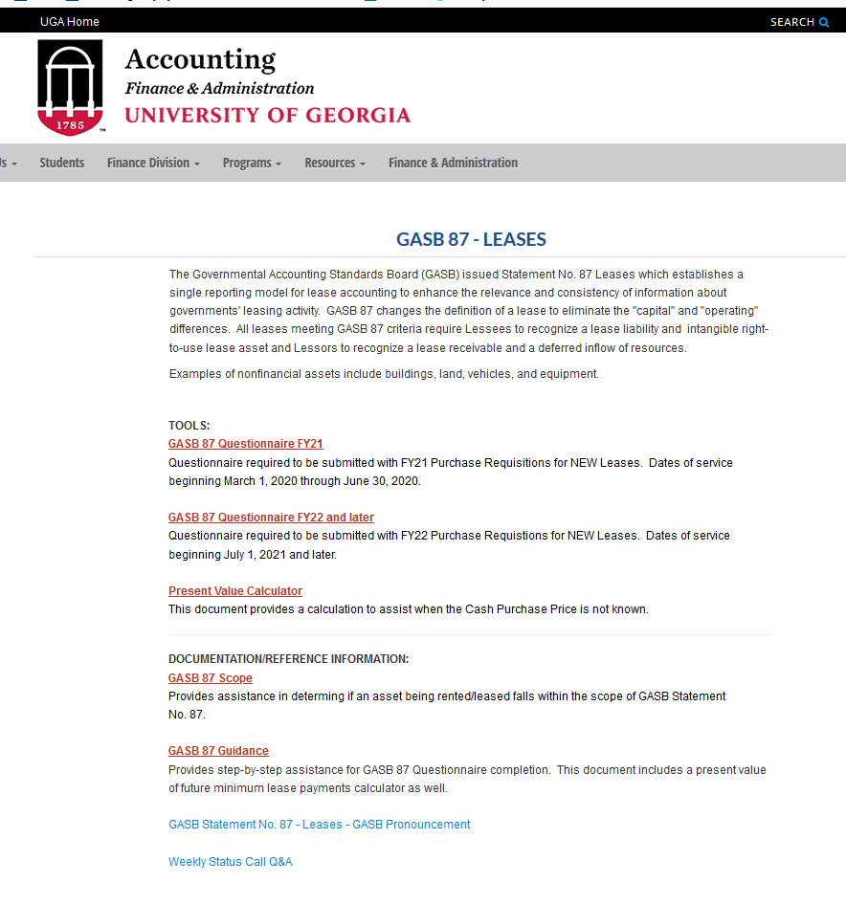
Accounting GASB Pronouncements Webpage – Cont.
NOW Available!!!

Slide 51

Accounting
Darlene McConnell darlene.mcconnell@uga.edu
706-542-6874
Accounts Payable – Travel and Encumbrances
Westley Bargo actpay@uga.edu
706-542-6767
Asset Management
Craig Mathews property@uga.edu
706-542-6981
Procurement
Chad Cox procure@uga.edu
706-542-7109
CONTACT INFO:

