Slide 1
DLB1
QAR: Quarterly Amendment Review UGA Budget Management System
Website: busfin.uga.edu/budget Email: budgets@uga.edu Phone: 706-542-2802
website: onesource.uga.edu
email: onesource@uga.edu service desk: 706-542-0202

Slide 2
Agenda
Concepts of the QAR Report
Reviewing the QAR Report
Running the QAR Report
Resolving Overdrafts
Resolving Under Budgeted Revenue
Timeline and Best Practices

Slide 3
Purpose of Training
Understand the reason behind the QAR requirements
Understand the QAR process
Know whether or not action is needed
Running Reports to fulfill the QAR requirements

Slide 4
Definitions
Fund - a pool of money allocated for a specific purpose
Account code - Used to identify transactional activities
Revenue – income generated by the sale of goods or services
Expense – cost of operations
Includes Personal Services and Non‐Personal Services
Budget Balance =
Current Budget minus (-) Actuals & Encumbrances
BudRef - The budget reference chartfield, which is the budget fiscal year of when funds were allocated or budgeted

Slide 5
Definition of QAR
Quarterly Amendment Review (QAR)
Report used to ensure there are no overdrafted fund codes starting with a “1” by intermediate unit
The report is broken down by fund code and account code type (Revenue, Personal Services, Non-Personal Services)
Goal: Have a positive balance for each fund code starting with a “1” within the school/college/unit

Slide 6
Concept 1: Why
Why is the QAR report important?
The University of Georgia reports the budget to the Board of Regents (BOR) and the Governor’s Office of Planning and Budget (OPB) on a quarterly basis.
The school/college/unit is responsible for keeping a positive budget balance in all fund codes starting with a “1” by the due date for each quarter.

Slide 7
Concept 2: Board of Regents (BOR) & Governor’s OPB Requirements
Each Intermediate Unit (IU) Level in balance by:
Any Fund Code that begins with a “1”
Account type: Revenue, Personal Services, Non-Personal Services
University Budget Office (UBO) reports all fund codes by account type as listed in the QAR
All fund codes must be true and accurate

Slide 8
Concept 3: UGA Requirements
Monthly review of the budget
School/college/unit review QAR near quarter end
Take corrective action if needed
Be in balance by a set deadline

Slide 9
Concept 4: Action Items
Action is needed if:
Any budget balances are in RED
Any budget does not represent a true picture of anticipated revenue or expense

Slide 10
Reviewing the QAR Report
DLB3
DLB4
DLB5

Slide 11
QAR Report Updates
Reordered the Funds
Removed 15000 IDC Revenue
School of Red & Black

Slide 12
Reviewing the QAR
Report A
Is action required?
No
School of Red & Black

Slide 13
Reviewing the QAR
Report B
Is action required?
Yes
Where?
Fund 14100
Fund 15000
College of UGA

Slide 14
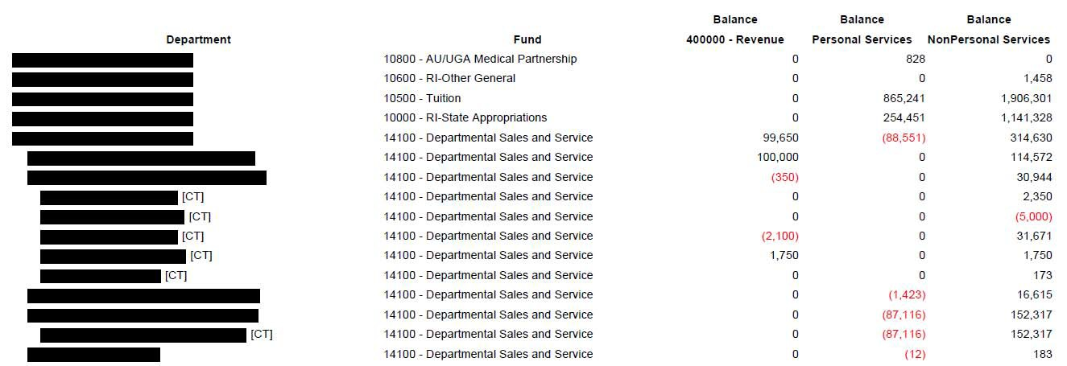
Reviewing the QAR
Drill down to a granular level
DSS Funds
Revenue that is not budgeted
College of UGA
UGA Depart #1
UGA Depart #2
UGA Depart #3
UGA Depart #4
UGA Depart #5

Slide 15
Running Reports in UGA Budget Management System
This Photo by Unknown Author is licensed under CC BY‐SA

Slide 16
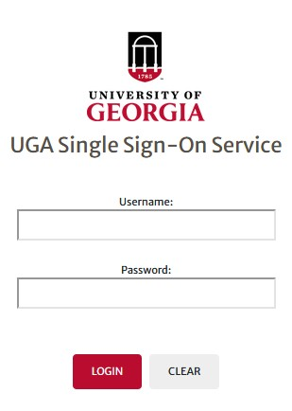
Running Reports
VPN/Cisco
University Budget Office
https://onesource.uga.edu/resources/budgeting/

Slide 17
Resolutions
Budget journals or budget transfers
Move or increase budget amounts as needed
Processed within UGA Financial Management
GL journal entry
Move the actuals off the current chartstrings
Processed within UGA Financial Management

Slide 18
Timeline
Quarterly Amendment Review (QAR)
Required to be in balance by QAR deadline dates
Quarter 1: September 24, 2021
Quarter 2: December 17, 2021
Quarter 3: March 25, 2022
Quarter 4: TBD
https://busfin.uga.edu/budget/

Slide 19
Best Practices
Monitor your budget on a regularly basis
Run the Monthly Overdraft report and QAR report weekly
Utilize the reporting systems that you are comfortable with
Reports – UGA Budget Management
Budget Status Report – Data Warehouse
Budgets Overview Page – UGA Financial Management
UGA_KK_DEPT_EXP_REV_BALS – UGA Financial Management

Slide 20
Key Takeaways
Every fund beginning with a “1” must have a positive balance by account type at the school/college/unit level
If revenue is negative….action is required

Slide 21
Any Questions?

Slide 22
Additional Resources
Budget Journal –UGA Financial Management System
https://training.onesource.uga.edu/UPK_Training/OneSourceOL/Publishing%20Content/Player Package/index.html?Guid=b88c302f-c782-4540-97c9-bd8cbcd9cccf
Budget Transfer- UGA Financial Management System
https://training.onesource.uga.edu/UPK_Training/OneSourceOL/Publishing%20Content/Player Package/index.html?Guid=7f865134-60cf-4d3f-9a77-f0b7af28228e
Budget Amendment – UGA Budget Management System
https://training.onesource.uga.edu/UPK_Training/OneSourceOL/Publishing%20Content/Player Package/index.html?Guid=cd2dd1ab-6e97-4f51-bcd8-04cdcea3b9f5&bypasstoc=0
Transaction Correction Method by Journal Sources https://onesource.uga.edu/_resources/files/documents/journal_correction_method_qrg.pdf
OneSource website Resources page https://onesource.uga.edu/resources/

