Slide 1
Departmental Sales and Service Activities

Slide 2
Objectives
Departmental Sales and Services (DSS) Defined
  Allison Davis- University Business and Accounting Services
Sponsored Activity vs. DSS Activity
  Dr. Regina Smith – Office of the VP for Research
Contract Review by Office of Legal Affairs
  Susan Wells – Office of Legal Affairs
Review of DSS Account Management
  Kevin Burt and Dr. John Wunderlich - OVPR
  Karen Barger – Carl Vinson Institute of Government

Slide 3
Departmental Sales and Services
Self supporting business activities which are categorized as either sales and service of educational activity or service center
Funds generated by DSS activity are considered institutional funds and should only recover costs for providing the sales or service

Slide 4
Departmental Sales and Services
  Examples:
  Sales of by-products from instructional or research related activities
  Conferences & Workshops
  Testing or analysis services *
  Sales of scientific and literary publications
  Clinical Services *
  Lab/Course Supply Fees
  *Could also be a Service Center

Slide 5
Departmental Sales and Services
What rules apply to DSS Accounts?
Budget is required each fiscal year
  Provides an estimate of income and related expenses and allows for budget balance validation by transaction
Accounts Receivable and Revenue Recognition
  Sales and services billed after rendered
  Billings should be timely and adequately documented
  Year-end billings should be recorded to ensure that revenue is recognized and recorded in the same fiscal year that the expenses are incurred

Slide 6
Departmental Sales and Services
What rules apply to DSS Accounts?
Deferred (unearned) Revenue
  Unearned revenue from external sources should be recorded. Requests to defer revenue should be sent to the Accounting department at year end
Carry Forward
  50% of revenue from external sources
  Pertains to only those actual excess revenues earned in the current fiscal year
  Carry forward should be spent within the first 90 days of the next fiscal year

Slide 7
Account Responsibilities
DSS account managers are required to:
Prepare an annual budget
Establish and document billing rates
Ensure proper revenue & expenditure recognition
Timely billing for products/service
Depositing of cash receipts on a timely basis
Ensure costs charged to DSS activities are reasonable and necessary to the operation of the activity
Maintain records to support account operations/activities

Slide 8
Additional DSS Resources
Policies and procedures http://www.policies.uga.edu/FA/nodes/view/917/Sales-and-Service-Activities
Carry forward guidelines and request form: http://www.busfin.uga.edu/forms/dss.pdf
Lab/supply fees policy: http://provost.uga.edu/index.php/policies-procedures/academic/academic-affairs/4-general-policies/407-miscellaneous-course-policies/407-14-approval-of-course-labsupply-fees/
Service Center policy: http://www.busfin.uga.edu/disclosure/pol_pro/service%20center.pdf
Accounting department contacts for questions:
Allison Davis – ahdavis@uga.edu
Celise Elder – celder@uga.edu

Slide 9
Sponsored Activity vs.
Departmental Sales and Service

Slide 10
Sponsored Projects
Sponsored Projects are typically scholarly activities integral to one or more of UGA’s three missions (teaching, research, and service).
They usually require the intellectual contribution of at least one UGA employee, and they usually (but not always) allow for the University to own resulting intellectual property and for the publication of results without significant restrictions.

Slide 11
Sponsored Projects typically have some or all of the following characteristics:
Intellectual or scholarly contribution.
Formal proposal or award document.
An itemized budget, including indirect costs.
Cost-sharing may be involved.
Restrictions on how funds can be spent (sponsor approval may be required to re-budget funds).
Unexpended funds must be returned.
Novel intellectual property may be developed.
Compliance terms and conditions
+
+
Sponsored Programs

Slide 12
Sales and Service Activities
A Sales and Service Activity is routine work that involves standardized procedures or procedures supplied entirely by the outside party funding the work. The outcome of the work is not likely to result in the development of new knowledge or publishable information, and any data collected is to be provided without significant interpretive analysis.
+
+
Sponsored Programs

Slide 13
Sales and Service Activities typically have some or all of the following characteristics:
Scope of work describes routine or repetitive services.
Work will require little or no intellectual or scholarly contribution.
No new intellectual property is expected.
No scientific uncertainty regarding the University’s ability to perform.
Significant interpretive analysis or conclusions or prescriptions.
No expectation of publishing on the work or the data.
+
+
Sponsored Programs

Slide 14
Office of Legal Affairs
Contract Review and Signature Authority

Slide 15

OLA USE ONLY
Received: ____ /____ /____
Completed: ____ /____ /____
CONTRACT ROUTING AND APPROVAL FORM
Office of Legal Affairs
GENERAL INFORMATION
Requesting Department ______________________________________________________________________ Contact Person ______________________________________________________________________________ Address ____________________________________________________________________________________ ____________________________________________________________________________________________ Telephone (______) __________________ Fax (______) _______________________ Email __________________________________________________________________ Requested Date of Return ____ /____ /____ (PLEASE ALLOW AT LEAST 2 WEEKS FOR REVIEW)
SUMMARY OF CONTRACT TERMS
Contract with _______________________________________________________________________________ Description of Contract _______________________________________________________________________ ___________________________________________________________________________________________ Dates Start ____ /____ /____ End ____ /____ /____ Payment(s) Due _____________________________________________________________________________ Authorized Signatory ___________________________________________________________________ IDENTIFY WHO WILL BE SIGNING ON BEHALF OF UGA

Slide 16
CHECKLISCHECKLIST
REQUIREMENT | DESCRIPTION | CERTIFIED COMPLETE BY: (PLEASE INITIAL)
Contract, Exhibits and Appendices | The contract and all documents incorporated by reference in the contract, including exhibits and appendices, are attached.
 | All such documents have been read and agreed to in their entirety by originating department and any faculty and staff members who have obligation under this contract.
Contracting Party | The name of the contracting party is stated as the ”Board of Regents of the University System of Georgia by and on behalf of the University of Georgia.”
Name, Address, Contact Person | The full name, address, legal status (i.e., corporation, partnership, etc.) contact person, and execution authority of the representative of the other party are included.
Understanding | The written contract matches the verbal understanding of all parties. All terms and conditions conform with the final negotiations/agreement of the parties. No supplementary verbal or written agreements were made.
Competition/Conflicts with Existing Contracts/ Compliance | The contract does not conflict with any other contracts, promises, obligations, or the mission of the University.
 | The requesting department verifies the University can comply with all terms and conditions and that those carrying the contract can meet the terms of the contract (e.g., the work can be completed, and it can be completed according to any time limits provided in the contract, we will be able to hire the personnel specified in the contract, etc.).
Conflict of Interests | The other party is not a public official or an employee of the University, the Board of Regents, or another University System institution. The other party is not an entity in which UGA employee or a member of UGA employee’s family is sole proprietor, partner, or owns 25% or more of the stock or assets.
Conditions or Obligations | If the contract contains any conditions or obligations, “triggering” event(s) are clearly defined.
Other Necessary Agreements | All other necessary agreements or waivers referred to in contract have been/will be obtained.
Procurement | The appropriate procurement officer has been consulted regarding the purchase of goods or services being acquired under the contract, to confirm that all applicable procurement rules and regulations have been followed.

Slide 17
CHECKLISCHECKLIST
REQUIREMENT | DESCRIPTION | CERTIFIED COMPLETE BY: (PLEASE INITIAL)
Warranties/Guarantees | Warranties or guarantees from the other party give satisfactory protection.
Insurance | The department is agreeable to any insurance clause(s). The Office of Legal Affairs must approve any insurance clauses.
Governing Law Jurisdiction | The contract does not permit any legal action to be taken in any other state or country or apply the law of another state or country. The contract does not permit legal action to be taken in federal court.
University Logo | If the contract allows the other party to use the University’s name, logo, or other trademark associated with the University of Georgia, the use has been approved by the appropriate University official.
Intellectual Property | All intellectual property issues (copyright, trademark, patent) have been addressed.
Confidentiality Agreements | All nondisclosure clauses include exceptions regarding disclosure as required by law or by a court of law. If not applicable, indicate ”n/a.” All nondisclosure or confidentiality provisions must be approved by the Office of Legal Affairs.
Printed/Typed Names | The names of all persons signing the contract are printed or typed below the signature.
Signature Authority | The person signing the contract on behalf of the University is authorized to do so.
Total Cost Involved | The contract involves $_______________ [to] [from] (circle one) the University.
 | Provisions for payments to or from the University are clear.
Default | The contract provides for events of default for each party.
 | The events of default are described with clarity and specificity.
 | There are provisions for notification of default and a method to cure any default by the University.
Termination Clause | The contract includes a termination clause that provides the University with a way legally to end the contract earlier than the specified date and set out acceptable terms for such termination.
 | If the contract includes a termination clause for the other party, the terms are acceptable to the University.
Authorization | Commitments have been obtained from the proper administrators for all resources to be provided by the University.

Slide 18
Payment | All University funds committed by this agreement are to be paid in the current fiscal year or are on hand and may be committed for payments in future fiscal years.
 | The contract clearly established place, time, and method of payment.
Unrelated Business Income Tax | If the contract involves any payment to the University, the issue of Unrelated Business Income Tax (UBIT) has been reviewed by the Controller’s Office.
Prohibited Provisions | All prohibited provisions have been deleted or modified. Any of the following must be deleted or reviewed by the Office of Legal Affairs: Indemnification. The University may not indemnify, hold harmless, be liable to, or reimburse any other party to the contract for claims, lawsuits, damages, or losses incurred by that party in connection with the contract. Liability Limitations/Waiver of Claims. The contract does not limit the other party’s liability or waive claims. Statute of Limitations. The contract does not attempt to limit the time frame in which the University can file a lawsuit. Term of Contract. Starting and ending dates of the contract are included and clearly defined. Automatic Renewal. The contract does not provide for automatic renewal. Warranties/Guarantees. There are no warranties or statements guaranteeing satisfaction from the University. Defense of Suit. Contract does not provide for anyone other than the Georgia Attorney General to represent or defend University in a legal action and does not allow the other party to control the defense of any legal action. Waiver of Jury Trial. The contract does not waive the right to a trial by jury. Confidentiality. The contract does not provide that its terms are confidential. Interest, Penalties, Late Fees. The contract does not provide for payment of interest, penalties, or late fees. Arbitration/Mediation. The contract does not contain any provisions pertaining to arbitration or mediation. Non-solicitation of the other party’s employees. The contract does not restrict the University from soliciting or hiring the other party’s employees. Payment of taxes or reimbursement for taxes. The contract does not require the University to pay or reimburse the other party for taxes. Security interest/UCC-1 document. The contract does not allow the other party to file a UCC-1 filing statement or otherwise give the other party a security interest in University property.

Slide 19
CERTIFICATION OF REQUESTING PARTY REQUESTING PARTY
I have read this contract entirely. I am satisfied with its description of the goods and/or services to be provided to the University (including, for example, warranties, delivery terms, acceptance period, and maintenance terms). I am also satisfied with the description of the University’s obligations (including, for example, scope of work, payment due dates, insurance, and confidentiality requirements) and all other provisions of this contract, except as noted in any attached memorandum. A memorandum [is], [is not], (circle one) attached. _______________________________ _______________________________ _______________ Signature Name Date _______________________________ Title

Slide 20
Rate Setting for Departmental Sales & Service
(DSS) accounts
UGA Instrument Shop Case Study
Dr. John Wunderlich
Kevin Burt

Slide 21
Importance
Budgeting
Full Cost Recovery
Comparison

Slide 22
Budgeting
Preparation– Allows units to properly prepare the budget for the next fiscal year
Duties – Assign employees to specific duties based on their skill and pay rate
Time allocation– Sets the expectation for tasks

Slide 23
Full Cost Recovery
Task specific– Provides a method for the unit to identify all the costs associated with a task and recover those costs based on the rate of the service(s) the task supports
Limit overcharging– Units are only allowed to recover the costs incurred to provide the service
Service Review- Provides units with information to determine if the service should be continued based on full cost recovery. If the service is too expensive and few people use it, then the service should be evaluated for elimination.

Slide 24
Comparison
Open market– Is the open market so competitive that the unit is unable to compete?
Other University Units - Is there anyone else on campus providing a similar service? How do your rates and level of service compare?
Peer Groups – Compare services and rates to Comparator and Aspirational Institutions.

Slide 25
Data Needed to Set Rates
Identify the specific service provided
Personnel involved – administrative, technician, research scientist
Office expenses – paper, ink, office supplies, postage, telephone, internet, shipping charges
Job specific supplies – dedicated computer, software, lab plastics, solvents (chemicals), gloves, goggles, shipping containers, dry ice, service specific equipment
Related activities – regular maintenance, area clean up, data clean up, service contracts
Additional support – departmental, college, or University

Slide 26
Specific Service
Sample processing
Machining, equipment repair, part fabrication
Synthesis
Testing
Product sales

Slide 27
Personnel Involved
Administrative staff – answering phones, customer services, order tracking, invoicing, billing, and reconciling monthly status report.
Technician – process samples, prepare/run/clean/repair instrumentation, communicate with customer
Research Scientist – review work, communicate with customer, calibrate instruments

Slide 28
Office Expenses
Paper, ink, and other office supplies
Postage
Telephone/internet
Shipping charges

Slide 29
Job Specific Supplies & Expenses
Dedicated computers
Software
Lab supplies - plastics, glass, solvents (chemicals), gloves, goggles, shipping containers, dry ice, service specific equipment
Deionized water
Paint, special paper, printer ribbon, labels
Filters, bulbs, belts, blades
Equipment service contacts

Slide 30
Related Activities
Regular maintenance of equipment – wash down, filter changes, lubrication, software updates
Area cleanup
Failure rate

Slide 31
Additional Support
Supplemental funds from:
    Departments
    Colleges
    VP for Research
    University
  These may or may not influence the rate charged to the users

Slide 32
CASE STUDY
UGA Instrument Shop
WaterJet Metal cutting machine

Slide 33
Specific Service
WaterJet Cutting Machine
Personnel involved –
  Instrument maker to operate the WaterJet
  Shop manager for review
Office expenses – internet charges
Job specific supplies –
  crushed garnet sand
  shop towels
Related activities –
  regular maintenance
  area clean up

Slide 34
Personnel Cost Assumptions
WaterJet Cutting Machine
 |  | Employee Potential
 |  | Assumes 40 hours per week
 |  | 2088 | Business Hours in FY15
 |  | (96) | LESS Holiday hours (12 UGA holidays FY15)
 |  | (64) | LESS Estimated Annual Leave hours (8 days)
 |  | (40) | LESS Estimated Sick Leave hours (5 days)
 |  | 1888 | Potential Hours to work
 |  | 90% | Potential work hours

Slide 35
Personnel Cost Assumptions
WaterJet Cutting Machine
Shop Manager –
  Work/job review (12 jobs per hour)
  Annual Salary $40,000
  Reviews finished parts and CAD drawings when needed
Instrument Maker –
  Job set-up (6 jobs per hour)
  Annual Salary $30,000
  Does not have to continually watch machine

Slide 36
Personnel Cost Calculations
WaterJet Cutting Machine

Slide 37
Personnel Cost Calculations
Time Allocation
NOTE
  If an employee is assigned to monitor an instrument or machine the entire time it is in operation, then their rate is charged for the full time of operation.
  If instead, the employee initiates the machine and then moves on to other tasks or services, then only allocate the time required for direct interaction with the machine as part of the rate calculation.

Slide 38
Personnel Cost Calculations
Time Allocation
Example
  Research Scientist’s typical day
    4 hours operating device
    2 hours on telephone for other assigned duties not related to service
    1 hour answering e-mail
    1 hour for breaks and general office conversation
  Only 4 hours of the Research Scientist’s time is assigned to that device (not 8 hours)

Slide 39
Personnel Cost Calculations
How do you recover the other 4 hours
  Can the phone calls and emails be handled by another person?
  Can some of the time be assigned to another service based on the content of the phone conversations?
Assign the 4 hours to Other Fixed Costs and distribute among all services

Slide 40
Office Expense Calculations
WaterJet Cutting Machine

Slide 41
Job Cost Calculations
WaterJet Cutting Machine
Job Cost
 | Shop Manager |  |  | 5 minutes per job X ($32 per hour) |  |  |  | $ | 2.67
 | Instrument Maker |  |  | 10 minutes per job X ($24 per hour) |  |  |  |  | 4.00
 | Internet |  |  | 5 minutes per job ($0.06 per hour) |  |  |  |  | 0.01
 | Cloth towels |  |  | 4 per job ($0.20 each) |  |  |  |  | 0.80
 | Garnet Sand |  |  | ($17 per job) |  |  |  |  | 17.00
 | Annual Maintenance |  |  | $5,000 | /1888 | hours |  |  | 2.65
 | WaterJet Cost per job |  |  |  |  |  |  | $ | 27.13
Direct Costs associated with service

Slide 42
Assumptions
2088 hrs FY14 -http://www.busfin.uga.edu/budget_div/fiscal_2014.pdf
Fringe rates - http://www.ovpr.uga.edu/osp/frequent-info
Holiday Schedule - https://www.uga.edu/holiday_schedule/
Leave rates - http://www.hr.uga.edu/paid-days-off

Slide 43
The Carl Vinson Institute of Government

Slide 44
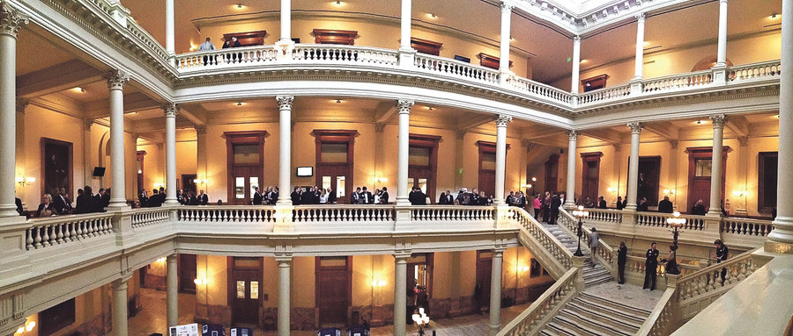
What Is…
Excellence in Government?

Slide 45
Excellence in Government
We help make governments BETTER
We help make governments that are more EFFICIENT and
RESPONSIVE to citizens.
This is achieved through a wide range of work…
Local and State Training
Studies and Research
Technical Assistance
Technology Solutions
International Training

Slide 46

Accounts

Slide 47
Active Accounts
10% State Accounts (G)
14% Departmental Sales and Service Accounts (DE)
21% Departmental Conference and Workshop Accounts (DW)
55% Restricted Accounts (R)

Slide 48

Budgets

Slide 49
Programmatic Budget Development
Anticipated Revenue
Budget Personnel Cost
* Salary
* Benefits
Budget Non-Personnel Costs
* Travel
* Operating

Slide 50

BILLING

Slide 51

Billing Rates
We work with our faculty to establish billing rates
Historical Analysis of Activity
Estimate Revenues & Expenditures
Analyze Projections for the Year
Make Adjustments
Continually Analyze

Slide 52

CONTRACTS

Slide 53
Overview
Contract Development
Contact with Client
Contract Template
Budget Template
Cooperative Effort (Faculty/Staff/Client)

Slide 54
Overview
Contract Execution
Office of Legal Affairs Review
Client Review and Signature
University Review and Signature

Slide 55

Georgia City/County Management Association
Contract
Contact with Client
Good Communication
Expectations Clearly Understood
Determination of Type of Account – 1031DW336036
Standard Contract
University Approved
Expedited Review
Client Contract
Not Preferred
Requires Greater Review
Slows Approval Process

Slide 56
Georgia City/County Management Association
Contract
Accounts Payable
Expenditure Review
Accounts Receivable
Invoice According to Contract Terms
Aging Report
Account Status Reports
Communicate with Faculty

Slide 57
Georgia City/County Management Association
Contract
Fiscal Year Closeout
UGA Cut-off Dates Memorandum
Budget Amendments (Revenue, Personal/Non-Personal Services)
Carry Forward Requests
Accounts Receivable Requests
Deferred Revenue Requests
Monitor account (credit card deposits and/or wire transfers that occur after UGA-cutoff

Slide 58
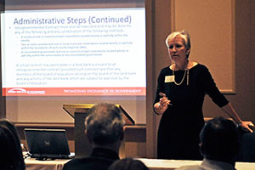
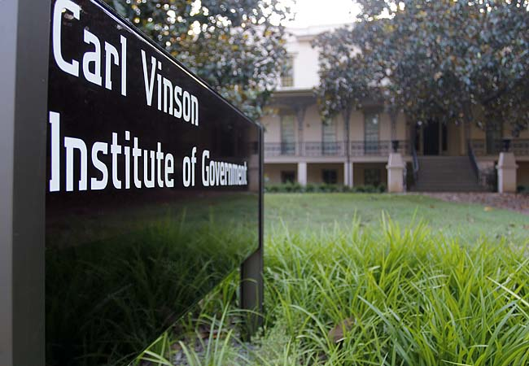
Local and
State Training

Slide 59
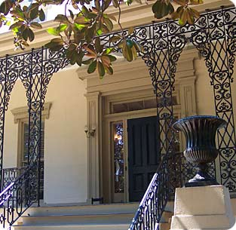
Questions?
Karen Barger
Associate Director
kbarger@uga.edu
706.542.6940

