Slide 1
University of Georgia
School of Medicine
Tuition Payment Plan
FAQ’S

Slide 2
Payment Plan Details
  The University of Georgia School of Medicine Tuition Payment Plan allows a student to defer up to 50% of their current term balance for tuition, mandatory fees, housing, and dining charges, or up to 50% of their account balance after all actual and expected financial aid is applied, whichever is less. Financial aid includes anticipated or disbursed aid, third-party contract payments, tuition and fee waivers, or other account credits.
A $75 non-refundable enrollment fee is assessed each term to offset administrative costs.
Students may be required to make a down payment at enrollment if their account balance after aid exceeds 50% of eligible term charges.
Deferred payments must be scheduled through automatic bank draft or credit card payment at the time of enrollment. Payment information should be kept current to avoid processing issues. Scheduled payments must successfully clear the bank to satisfy payment obligations. Failure to make payments as agreed may result in withdrawal from the term.

Slide 3
Q: What is the cost?
There is a $75 non-refundable enrollment fee per term due at the time you sign up.
In addition, a down payment may be required at enrollment if your student account balance after aid is greater than 50% of the term’s eligible payment plan charges-tuition, mandatory fees, housing (excluding monthly rates), and dining charges.
Q: Who is eligible?
Only students in the School of Medicine who have remaining balances after all financial aid payments are applied to their accounts are eligible for the School of Medicine Tuition Payment Plan.
Q: When can I enroll?
Enrollment for the Fall School of Medicine Tuition Payment Plan begins July 15th, 2026, and will continue through August 17th, 2026.
Please ensure all charges are on your account before enrolling.

Slide 4
Q: How do I enroll?
Sign up is done through your Athena Student Account.
Before enrolling in the payment plan, complete your registration and ensure all elective charges—such as housing (excluding monthly rates), meal plans, parking, and other fees—are posted to your student account. This helps ensure you only need to make one down payment.
A down payment is required only if your balance exceeds 50% of the term’s eligible payment plan charges, including tuition, mandatory fees, housing (excluding monthly rates), and dining charges.
Q: When are the two installments due?
For Fall 2026, the two installments will automatically process on September 3rd, 2026, and October 5th, 2026.
At the time of enrollment, students/parents are required to set up deduction of installment payments directly from a bank account via ACH or scheduled payments by a major credit card*.
Payments are then automatically drafted from your bank account or charged to your credit card*. Please ensure your bank or credit card information for scheduled payments is up to date to avoid issues with processing your payment.

Slide 5
Q: Am I required to wait until my installment is due to pay it?
Q: How do I pay my installment payments?
When you enroll in the payment plan, you agree to have the installments automatically drafted via ACH or credit card.* If you would like to make a payment before the scheduled installment date, you may do so manually. To avoid duplicate payment processing, please submit your payment at least 48 hours before the installment due date.
You can make payment of any amount towards your next installment. If you wish to make a payment before the installment date, this can be done manually at least 48 hours prior to installment date.
Q: Can my installment amounts change after I have signed up for the plan?
Yes. Your installment amounts may increase or decrease if there are changes to your tuition, fees, housing, meal plan, financial aid, tuition waivers, or account payments. Installments are recalculated daily, and you will receive an email notification should your installment payment amounts change.
NOTE: * Credit card payments will be assessed a convenience fee of 3% (minimum $3) per transaction for domestic cards and 4.25% for international cards by the vendor for this service.

Slide 6
Q: I paid off an installment, and now I see an amount due for it. Why?
Q: What if I need to use Flywire to pay off an installment?
Any Flywire payments will need to be scheduled to take effect 48 hours prior to the installment date.
Q: Can I use Flywire to enroll in the Payment Plan?
Yes. If you would like to enroll in the Payment Plan using Flywire, please contact our office for instructions on how to complete your enrollment.
An installment reopens if you have new charges on your account and the due date for the installment payment has not passed.

Slide 7
Q: What happens if I do not make either of the two installment payments as agreed or my payment is returned by the bank?
If either of the installment payments are not made as agreed, you will be withdrawn from the term. The withdrawal will appear on your transcript, and the University of Georgia refund policy will be applied based on the payment due date. Future payment plan eligibility may also be restricted.
Q: Why can't I enroll in a plan?
You cannot enroll in the University of Georgia School of Medicine Tuition Payment Plan if your balance is fully covered by financial aid.
Any outstanding balances from previous terms must also be paid in full before enrollment.

Slide 8
Q: I am on the payment plan and have a monthly Housing charge or other charges not included in the plan. How can I ensure my payments are applied to my current monthly balance rather than paying down my future installment plans early?
Q: Why do I see the message "you do not have enough eligible charges" when I try to enroll?
This message typically means that you do not have enough charges to qualify for the plan, or your balance does not exceed $100.
To pay any charges outside of the payment plan, use the “Make a Payment” button and then select the specific charge you want to pay. This will ensure that the payment pays the charge that is due and not the next installment.

Slide 9
Enrollment Instructions:
School of Medicine
Tuition Payment Plan
To sign up for the UGA School of Medicine Tuition Payment Plan or to determine how much you are eligible to defer under the plan, please follow these instructions.

Slide 10
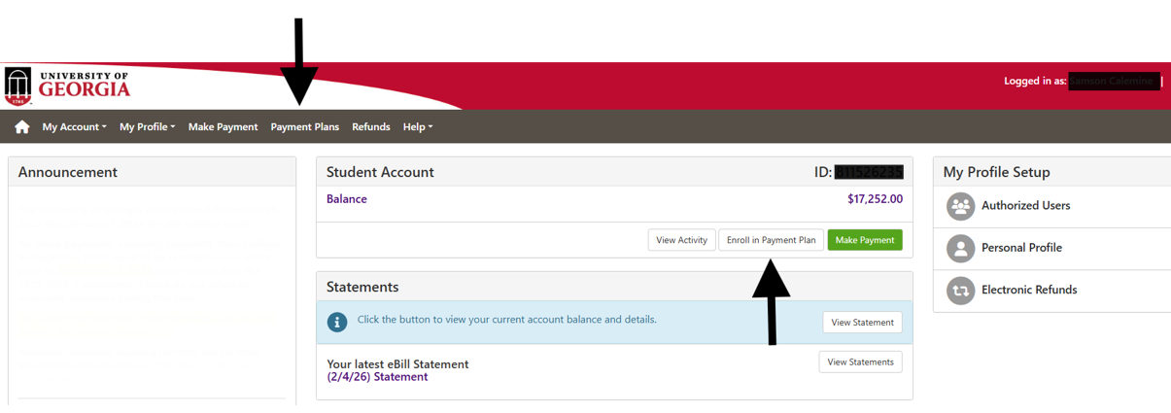
Once you have accessed your Student Account through Athena, select the Payment Plan section in the header or the Enroll in Payment Plan button.

Slide 11
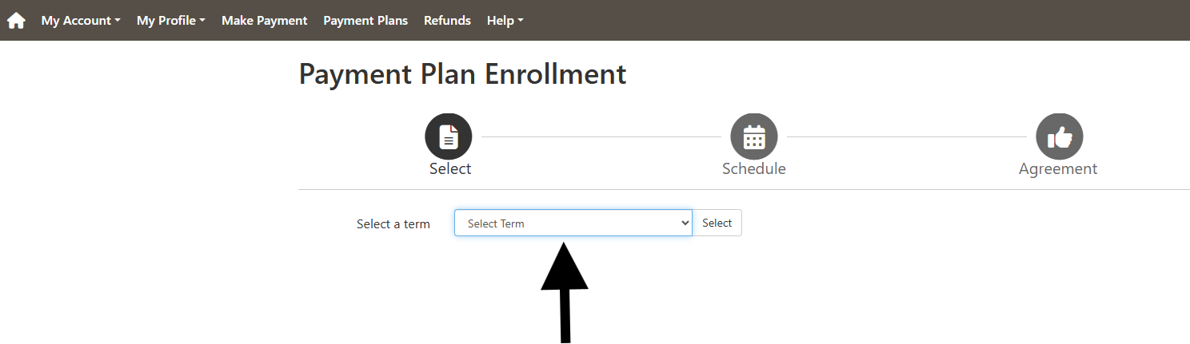
In the drop-down menu, select the term for which you are enrolling.

Slide 12
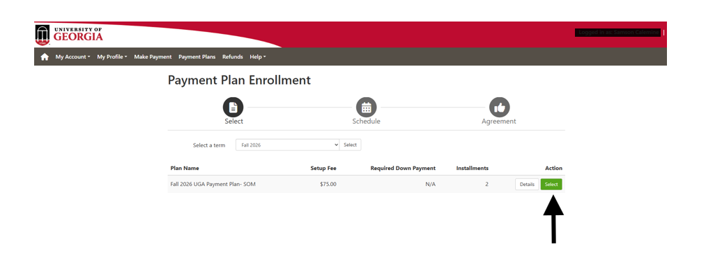
A screen will open and show the term that you are enrolling. If this is correct, click Select.
**If you wish to only view what your payment plan requirements would be, select Details. A small window will open that shows your payment plan description. If you do not wish to continue with the enrollment process, click Cancel. To continue with the enrollment choose Select.

Slide 13
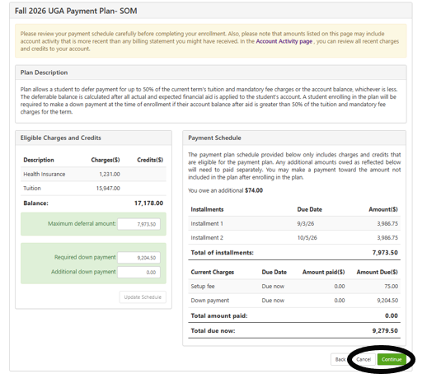
The Total due now is the sum of the down payment amount and the
$75.00 enrollment fee. To proceed with enrollment, click Continue. If you do not wish to enroll in the payment plan currently, click Cancel.

Slide 14
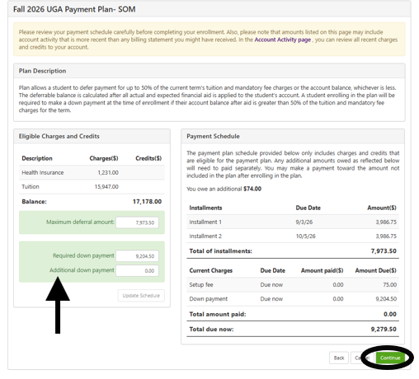
If you wish to pay an additional amount towards your down payment, key in the amount you would like to pay and select Update Schedule. This will show the new installment amounts based on the additional down payment.

Slide 15
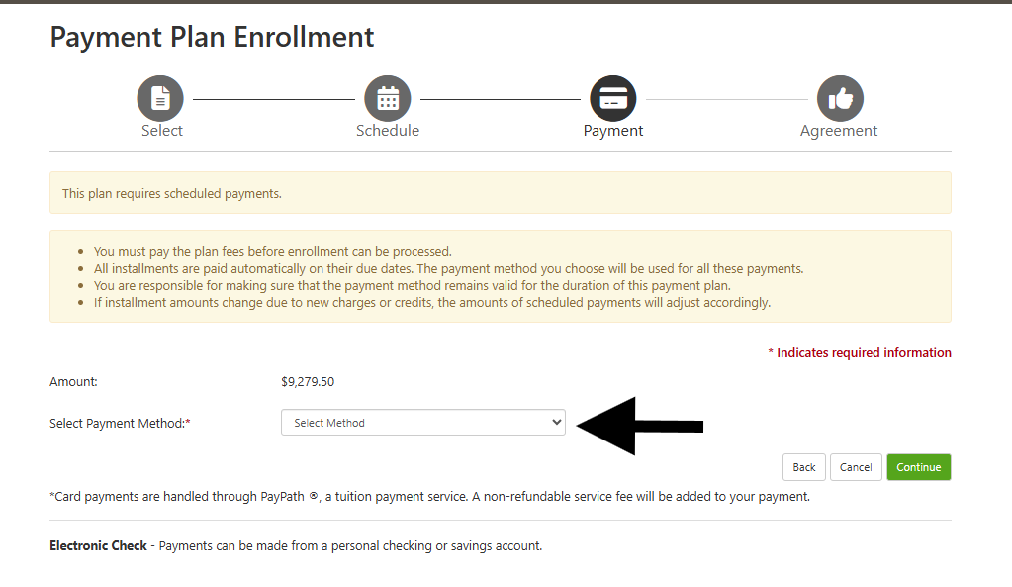
If you have chosen to enroll in the plan, The Select Payment Method screen displays. Installment amounts and down payments may be paid via ACH or with a major credit card. You will need to select the payment method that you wish to use from the drop-down menu and follow the payment prompts.

Slide 16
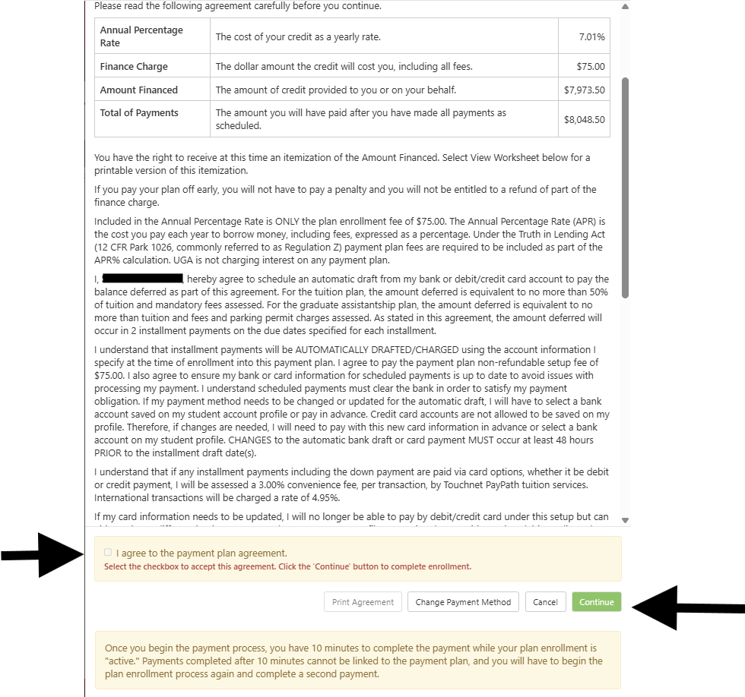
The Payment Plan Agreement is displayed showing the UGA Student Account Payment Plan details. If you agree to the terms, you must scroll to the end of the agreement, select the box next to I AGREE, and click Continue.

Slide 17
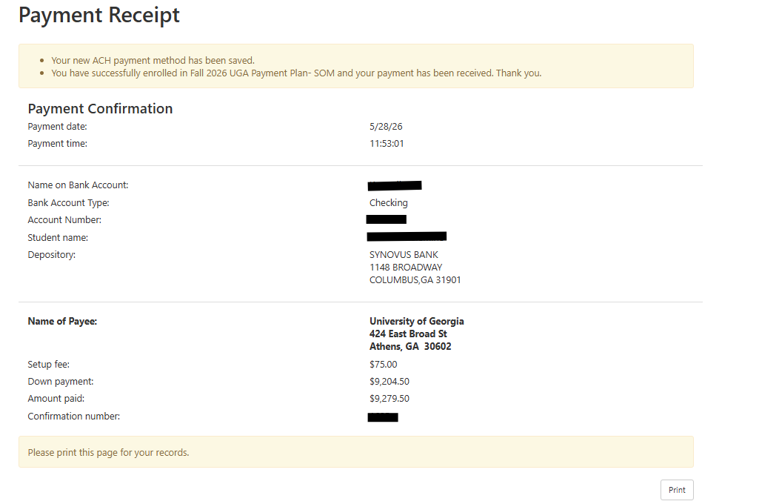
If you enroll, the next screen will show you your Payment Receipt which should be printed for your records. You will also receive an e‐mail confirming your enrollment and the due dates for your installments.

Slide 18
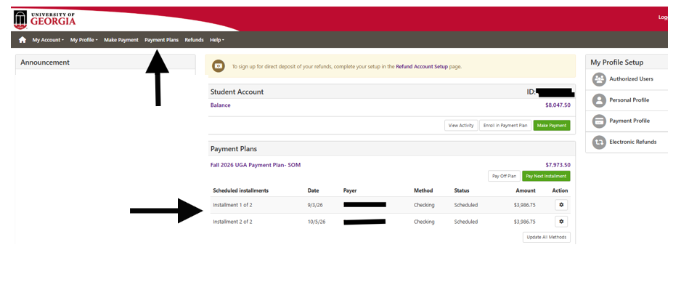
You may access your payment plan from your Student Account main page on the Payment Plans header or under the Scheduled Payments section.
*If your installment amounts increase or decrease, a follow-up email will be sent to indicate that the plan has been adjusted. If the adjusted amount deferred now exceeds the 50% amount you are eligible to defer, you will be dropped from the plan and asked to reenroll so that you can pay additional amounts towards the down payment considered due at the time of the enrollment. If you are asked to reenroll, you will not be required to again pay the payment plan setup fee of $75.00.

