Slide 1

GASB 96: Understanding and Implementing the New SBITA Accounting Standard

Slide 2
Discussion Points
GASB 96 Defined
Understanding Departmental Responsibilities
Identifying GASB 96 Criteria
Completion of GASB 96 Questionnaire with Examples
Renewal Contracts
Process for Renewal PO’s
Identifying SBITA ID Number
What is happening at each level of this process?
Other Items
Implementation Date – When do we start?
Resource Site – Where can I find information and forms?
SBITA ID Number Naming Convention – What does the number identify?
New Subscription Based IT (SBITA) Contracts

Slide 3
GASB 96 Defined
Why Change?

Slide 4
Why is the reporting for SBITAs Changing?
There is limited guidance currently available for Subscription-Based Information Technology Arrangements, which has led to various ways of recording the related costs (such as expensing versus capitalizing).
It has become common for government agencies to enter into subscription-based contracts to use vendor provided information technology (IT). In many cases, these subscription-based contracts extended beyond 1-year and create a financial liability for the government agency. GASB’s concern is that the current financial statement presentation does not reflect outstanding debt on SBITAs which could result in incorrect assumptions being made by users of the financial statements related to cash solvency of the governmental entity.
As such, GASB Statement No. 96 establishes a definition for SBITAs, and provides uniform guidance for accounting and financial reporting. Thus, improving the comparability, relevance, and reliability of financial statements.
All Software Contracts meeting GASB 96 Criteria must report a subscription liability and an intangible right to use subscription asset. Additionally, essential information about the arrangement must be disclosed on the financial statements.

Slide 5
GASB 96 Standard
GASB 96 states, "A SBITA is defined as a contract that conveys control of the right to use another party’s (a SBITA vendor’s) IT software, alone or in combination with tangible capital assets (the underlying IT assets), as specified in the contract for a period of time in an exchange or exchange-like transaction.”
Terminology in bold is broken down as follows:
  “Control of the right to use" – requires both a right to obtain present service capacity from the use of the underlying IT assets and the right to determine the nature and manner of use of the underlying IT assets.
  "IT software" – subscription-based information technology arrangements (SBITA) commonly include provisions such as remote access to software applications or cloud data storage and allows for temporary use that ends when the subscription expires.
  “Period of time" – the subscription term is the period of time that the government has a noncancellable right to use the underlying IT assets plus any periods that the government or vendor have the option to extend the contract and it is reasonably certain that the option will be exercised. UGA generally enters into subscription-based contracts for multiple year terms with an initial year and additional renewal options of 1-5 years.

Slide 6
Ask yourself…
Will this software still work or will I be able to log in
once the contract term ends?
If your answer is “no”, it is likely that a SBITA exists.

Slide 7
GASB 96 Cost Stages
At the commencement of the subscription term, a government should recognize a subscription liability and an intangible right-to-use asset (the subscription asset).
ACCOUNTING OVERVIEW
As of 01/20/23: $100,000 threshold is pending approval.
For SBITA contracts with a term greater than 12 months and that exceed a capitalization threshold of $100,000 in payments over the subscription term, the following will be recorded:
 | Liability | Asset
Commencement of Subscription Term* | Record subscription liability equal to present value of subscription payments (fixed payments, variable payments, that depend on rate, variable payments that are fixed in substance, payments for penalties, subscription incentives, and any other payments reasonably certain of being required) | Record subscription asset equal to subscription liability + capitalizable initial implementation costs payments made to SBITA at contract commencement + payments made to SBITA vendor at contract commencement
Subsequent Periods | Reduce subscription liability as payments are made for portion related to principal Record interest expense | Record amortization expense and allowance for amortization on subscripting asset over the subscription term using straight-line method
*The subscription term begins when the subscription asset is placed into service. This occurs when (1) the initial implementation stage is complete and (2) the institution has obtained the control of the right to use the underlying IT assets. For FY23 (implementation year), the total of the SBITA contract starts from July 1, 2022 (or the date the SBITA begins if after July 1, 2022) through the end of the subscription term.

Slide 8
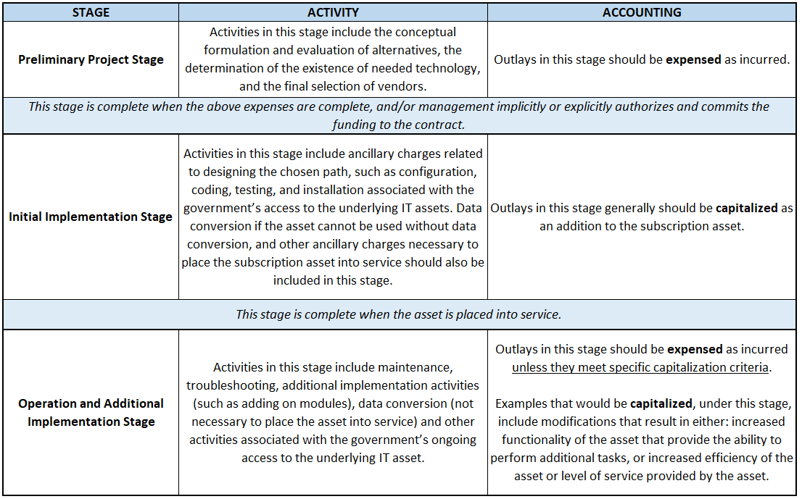
GASB 96 Cost Stages

Slide 9
Exclusions from GASB 96
Standalone IT Support/Maintenance service contracts that do not include the right to use an underlying IT asset
Contracts that convey control of right to use IT software and tangible assets that meet the definition of a lease in GASB Statement 87, where the software component is insignificant compared to the cost of the underlying tangible capital asset (for example, a computer with operating software or a smart copier that is connected to an IT system).
Contracts that meet the definition of a public-private and public-public partnership and availability payment arrangements in GASB Statement 94.
Licensing arrangements that provide a perpetual license to governments to use a vendor's computer software, which are subject to GASB Statement 51. A perpetual agreement gives the buyer the right to use the software for an indefinite amount of time (in perpetuity).
Short-term SBITA contracts, under 12 months including exercised renewal periods.
Governments that provide the right to use their IT software and associated tangible capital assets to other entities through SBITAs

Slide 10
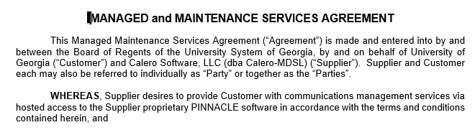
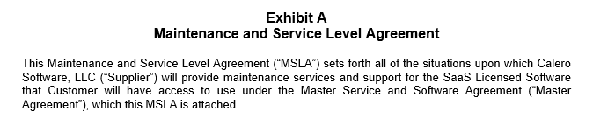
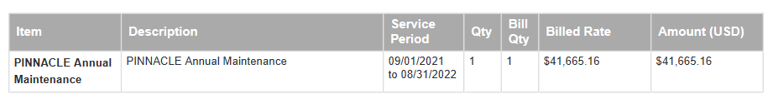
Exclusions from GASB 96
IT Support Maintenance Example Wording

Slide 11
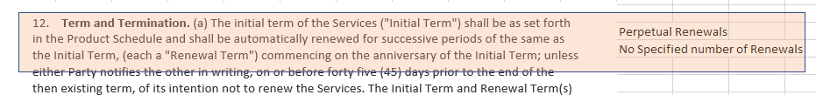
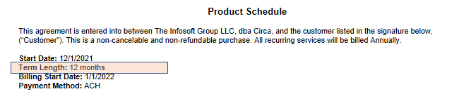
Exclusions from GASB 96
Perpetual Renewal Example Wording

Slide 12
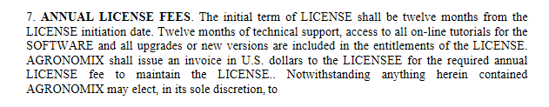

Exclusions from GASB 96
Year-to-Year Example Wording

Slide 13
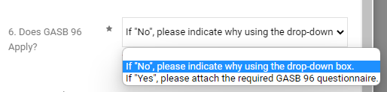
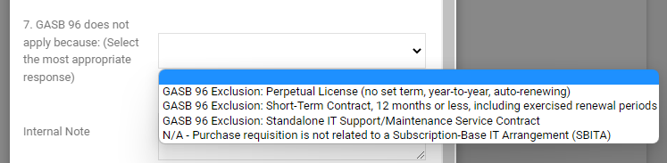
New SBITA Contracts
Required Question
Complete Purchase Requisition
  Similar to GASB 87, there are two unique GASB 96 Questions which are included to allow the user to choose common exclusions (such as a contract term under 12 months).
If an exclusion does not apply, the user is required to complete and attach the GASB 96 Questionnaire to the Purchase Requisition.
UGAmart will serve as the source or record for preliminary consideration and supporting documentation of GASB 96 standards.
**A tutorial on how to pre-populate requisition questions is available on our GASB 96 Website.

Slide 14
GASB 96 Examples
Notes:
We’ve now defined what a SBITA is, so I am going to walk you through some examples and our questionnaire to show you how to look at the contract.

Slide 15
GASB 96 Questionnaire
Example #1 – NOT GASB 96
SBITA DOES NOT Meet GASB 96 Criteria

Slide 16

Example 1: Excluded from GASB 96
Equipment purchase with perpetual software license (PO Number: E1308837)
Complete the UGAmart Prescreening:
Review the Agreement:
SBITA DOES NOT MEET GASB 96 Criteria,
you can stop at this point.
Notes:
Here is a great example of how the requisition questions will allow users to skip completing the questionnaire for some of the more common exclusions. Please note we will go through the workflow later in this presentation but these are being reviewed for accuracy at the requisition level and with the attachment of the questionnaire.
You can see the various common exclusions on the drop down. As mentioned we will also be posting a recording to our site on how to prepopulate these questions if this is something that you may rarely complete. That will be upload soon so keep an eye out.

Slide 17
GASB 96 Questionnaire
Example #2 - INSIGNIFICANT
SBITA Meets GASB 96 Criteria but the Present Value or Cash Price is less than the Capitalization Threshold.

Slide 18
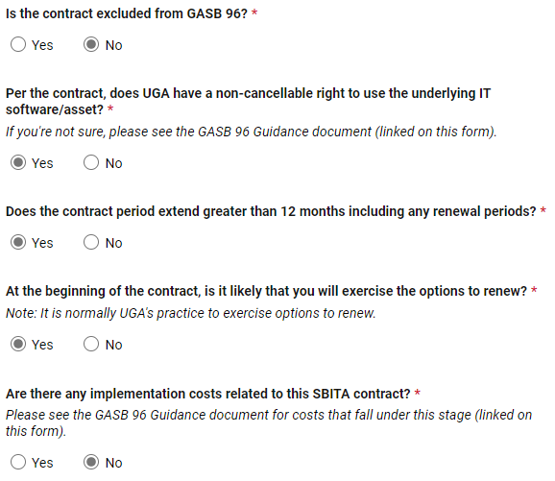
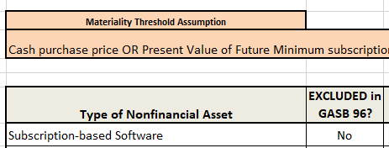
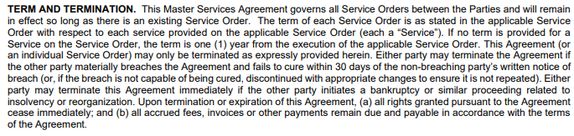
Example 2: INSIGNIFICANT GASB 96
Cappex (software) membership (PO Number: E1268869)
GASB 96 Scope Document:
Complete the GASB 96 Questionnaire:
Review the Agreement:
Notes:
Just a reminder that clauses for funding do not change the cancelable right determination.

Slide 19
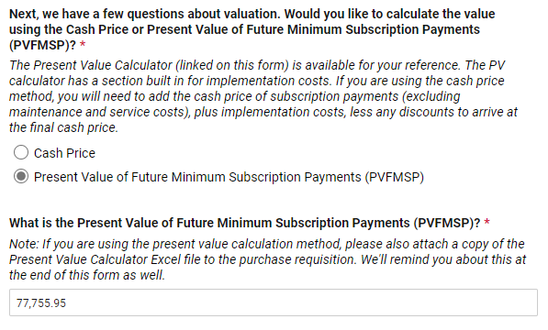
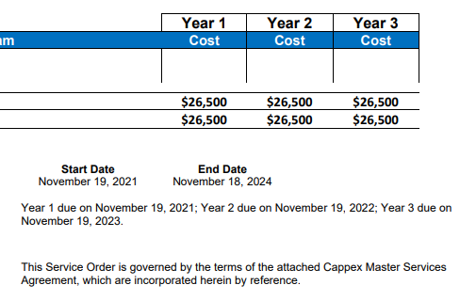
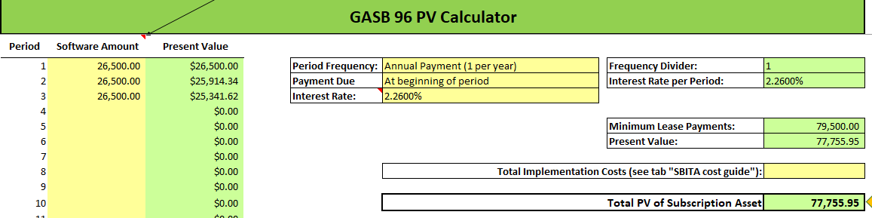
Example 2: INSIGNIFICANT GASB 96
Cappex (software) membership (PO Number: E1268869)
Review Agreement:
Present Value Calculator:

Slide 20
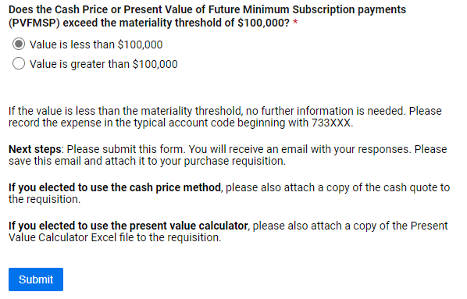
Example 2: INSIGNIFICANT GASB 96
Cappex (software) membership (PO Number: E1268869)
SBITA MEETS GASB 96 Criteria but is INSIGNIFICANT. Attach support and submit the form.
Notice the ONLY question that drives this determination is whether or not a SBITA meets Materiality.

Slide 21
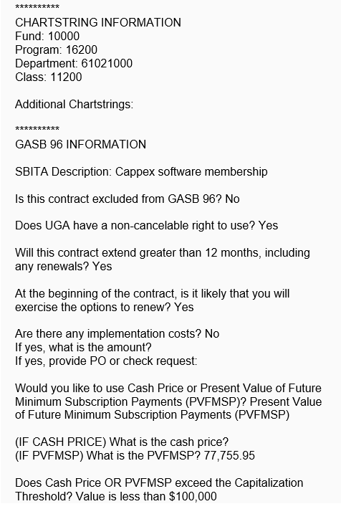
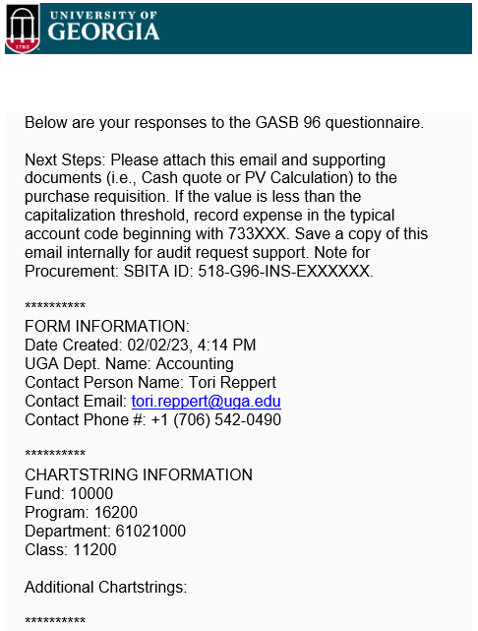
Example 2: INSIGNIFICANT GASB 96
Cappex (software) membership
(PO Number: E1268869)
Notes:
Here is an email summary, you are able to attach the email directly to the requisition for support
They review for accuracy and may reach out with questions

Slide 22
GASB 96 Questionnaire
Example #3 – GASB 96 SBITA
SBITA Meets GASB 96 Criteria – SBITA ASSET

Slide 23
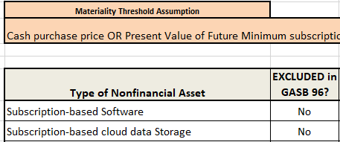
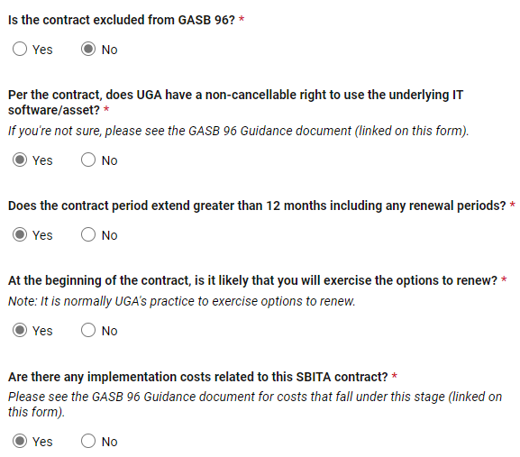
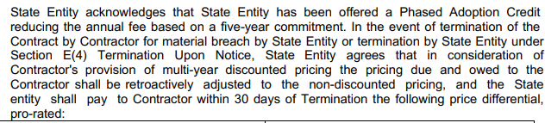

Example 3: GASB 96 SBITA
Cloud-based assessment management system (PO Number: E1262565)
GASB 96 Scope Document:
Complete the GASB 96 Questionnaire:
Review the Agreement:

Slide 24
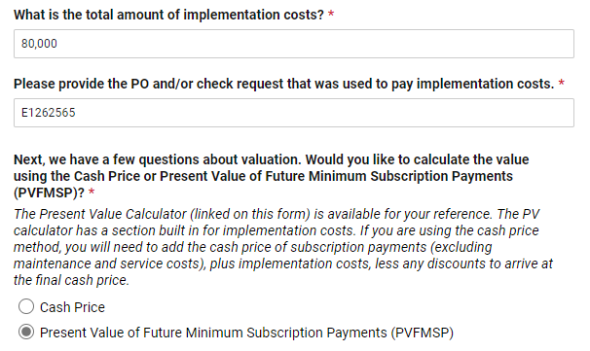
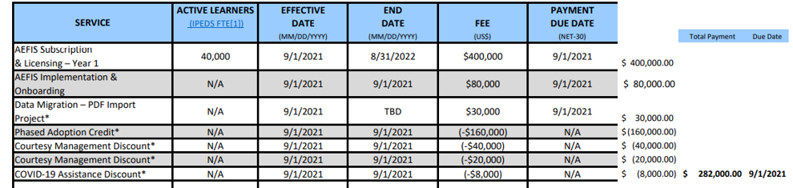
Example 3: GASB 96 SBITA
Cloud-based assessment management system (PO Number: E1262565)
Review the Agreement:

Slide 25
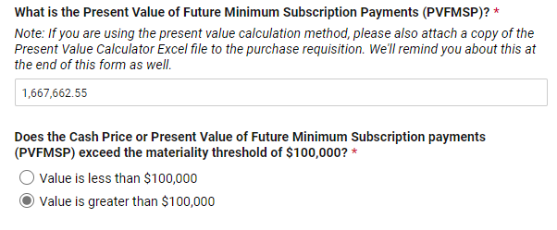
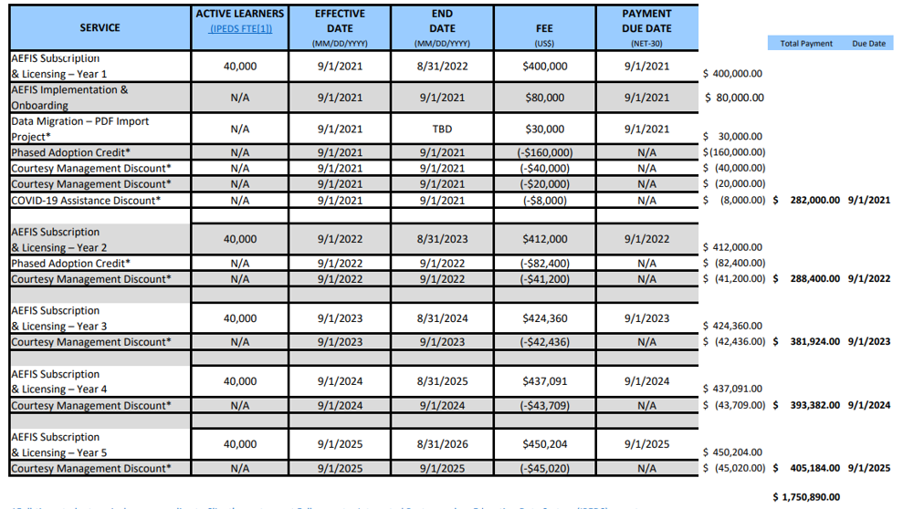
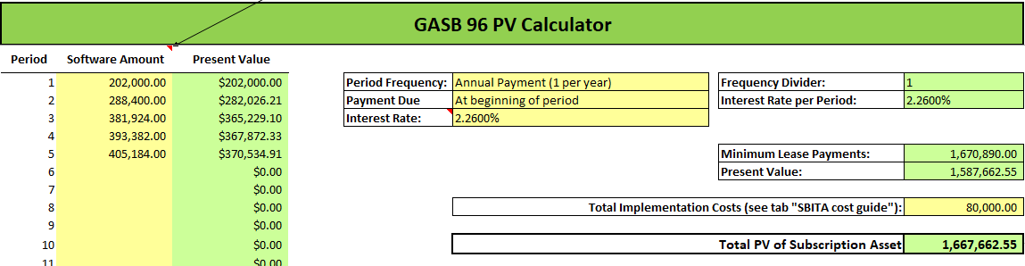
Example 3: GASB 96 SBITA
Cloud-based assessment management system (PO Number: E1262565)
Review the Agreement:

Slide 26
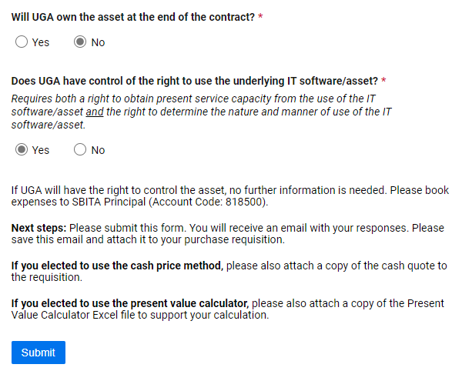

Example 3: GASB 96 SBITA
Cloud-based assessment management system (PO Number: E1262565)
Review the Agreement:
SBITA MEETS GASB 96 Criteria.
Attach support and submit the form.

Slide 27
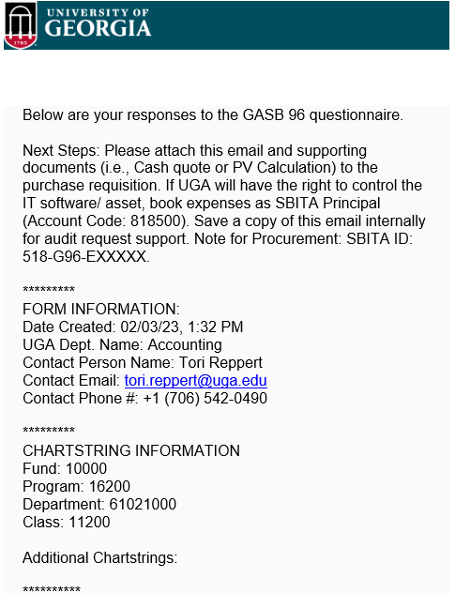
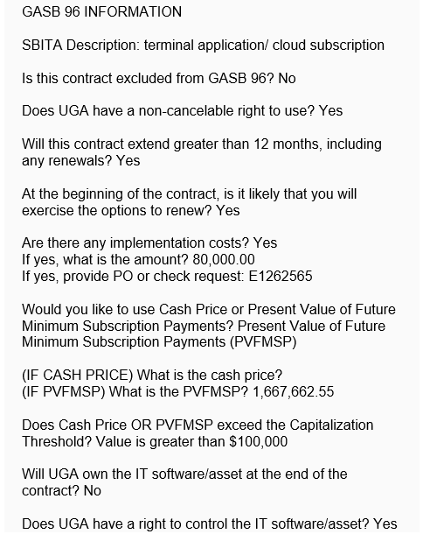
Example 3: GASB 96 SBITA
Cloud-based assessment management system (PO Number: E1262565)

Slide 28
Live Example
GASB 96 SBITA Questionnaire
Notes:
GASB 96 SBITA Questionnaire (smartsheet.com)

Slide 29
Renewals versus Amendments
Renewals - No change to contract terms (e.g., cost, term, software subscription, etc.)
  SBITA contract renewals will REQUIRE referencing SBITA ID Number on ALL subsequent year’s Requisitions. The SBITA ID number will be included on Purchase Order documents once requisition goes through various departmental workflow approvals.
    Multi-year contracts will be tracked as one SBITA throughout the various years of PO’s that are required by budgeting limitations.
    The GASB 96 website will have a listing of current PO’s with SBITA ID’s that should be used on FY24 Renewals. This will be available March 1st.
Amendments - Adjust contract terms (e.g., cost, term, modification/upgrade to software subscription, etc.)
  Generally will result in a change to the payments or terms that were originally agreed to.
  Requires resubmission of the GASB 96 Questionnaire.

Slide 30
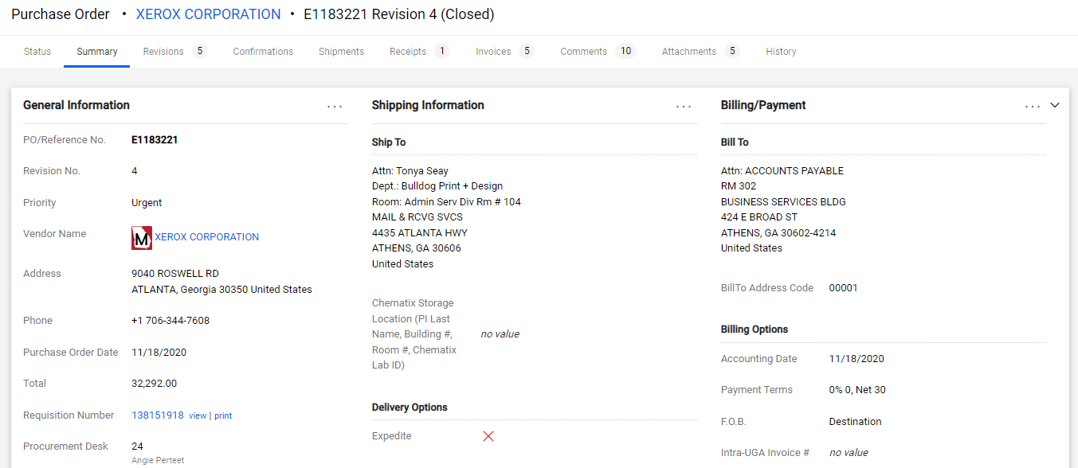
How to Locate SBITA ID Number:
The SBITA ID may be found in one of two places in the original PO.
FIND SBITA ID Number Here:

Slide 31
GASB 96 Process
Department Flow
Identification of how this process flows from initiation of requisition to identification in General Ledger.

Slide 32
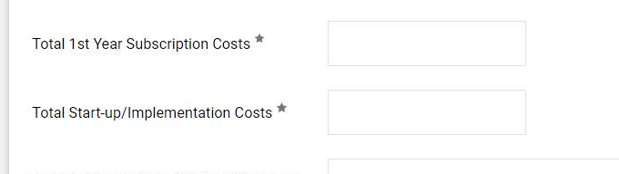
GASB 96 Process
Computer Equipment, Software & Services (CESS)
  NO CHANGE TO THIS PROCESS – follow current UGA policy to determine if CESS is required
  SBITA - Certain information provided on approved CESS forms will be used to gather information for determining that all costs of a subscription-based IT arrangement have been considered.
    CESS form provides a question related to “implementation costs”. Valuation of the subscription asset includes implementation costs. When answered, the Asset Management team will look for additional expenditures related to the SBITA valuation.
  NOTE: Sometimes implementation costs will not be known until after the terms of the contract have been agreed to by UGA and the SBITA Vendor. The GASB 96 Questionnaire will also provide an opportunity to identify implementation costs. There is no need to update the CESS for implementation costs if unknown at the time of CESS creation.

Slide 33
GASB 96 Approval Workflow
Department Level:
Initiator:
  Create Purchase Requisition in accordance with normal purchasing procedures
    Answer required question related to GASB 96 to identify initial determination of applicability of GASB 96 to item being purchased
  Complete GASB 96 Questionnaire if required (Not Excluded on Purchase Requisition)
    Provide adequate supporting documentation as noted by questionnaire results
Approver:
  Review Purchase Requisition in accordance with normal purchasing procedures
    Ensure that required GASB questions have been completed and correctly reflect determinations based on item being purchased.
  Review GASB 96 Questionnaire. Compare to Requisition for any mismatched information.
Once approved through department workflow, the requisition will flow to Accounts Payable.

Slide 34
GASB 96 Approval Workflow
Accounts Payable Level:
Review Purchase Requisition for GASB 96 determinations.
  Compare required question responses to items being purchased for appropriate answers.
Review GASB 96 Questionnaire responses
  When Purchase Requisition identifies that GASB 96 applies, compare GASB 96 Questionnaire and Requisition to ensure that information matches.
  Check that required supporting documentation has been attached to Requisition.
Purchase Requisition will be returned to the Department for the following:
  If Purchase Requisition is not answered correctly.
  Missing GASB 96 Questionnaire/supporting documentation when required questions reflect that GASB 96 applies.
  If the GASB 96 Questionnaire information/responses do not match the purchase requisition. Either the purchase requisition or questionnaire could require correction.
If the information is correct, AP will determine if appropriate Expense Account Code has been used on Requisition based on questionnaire answers.
  This may result in the Requisition Expense Account Code being changed
    Budget check of new chartstring could result in the Purchase Requisition being returned.
Once approved through department workflow, the requisition will flow to Asset Management.

Slide 35
GASB 96 Approval Workflow
Asset Management Level:
Review Purchase Requisition for GASB 96 determinations.
  Compare required question responses to items being purchased for appropriate answers
Review GASB 96 Questionnaire responses
  When Purchase Requisition identifies that GASB 96 applies, compare GASB 96 Questionnaire and Requisition to ensure that information matches
  Check that required supporting documentation has been attached to Requisition.
Purchase Requisition will be returned to the Department for the following:
  Account code is not correct
  If GASB 96 questionnaire determination appears inappropriate based on attached documentation.
Determine Asset Profile for the SBITA – completion of the asset profile will remain as pending until the first invoice is received from the vendor.
Once approved through department workflow, the requisition will flow to Procurement.

Slide 36
GASB 96 Approval Workflow
Procurement Level:
Review Purchase Requisition for GASB 96 determinations.
  Compare required question responses to items being purchased for appropriate answers
Review GASB 96 Questionnaire responses
  When Purchase Requisition identifies that GASB 96 applies, compare GASB 96 Questionnaire and Requisition to ensure that information matches
  Check that required supporting documentation has been attached to Requisition.
Finalize Requisition and create SBITA Contract
Create the Purchase Order
  Create and Add SBITA ID Number to PO for NEW contracts
Attach Contract and related GASB 96 supporting documentation to PO

Slide 37
GASB 96 Approval Workflow
Asset Management Level:
First Invoice from Vendor –
  Review and compare payment information to contract that is created by Procurement and Requisition
    Department will be contacted for any variances between contract and invoice (1st payment date, amounts billed, etc.)
Add SBITA Asset in Asset Management System
  Review CESS and GASB 96 Questionnaire for information on Implementation Costs.
    Research actual payments to vendors that should be included in SBITA Asset cost.
  SBITA data will be added and an amortization schedule will be created.

Slide 38
GASB 96 Approval Workflow
Accounting Level:
Monitor payments based on SBITA ID Number through various queries (GL and AM queries)
  Compare AM Module to UGA Mart
Annual Financial Reporting
  Prepare year end entries to adjust year end liability/expense activity
  Reconcile Debt Outstanding
  Prepare Capital Asset and Long-Term Debt Notes based on info in Actuals, GAAP and Capital

Slide 39
GASB 96 – Other Items

Slide 40
Implementation Schedule
July 1, 2022 –
  GASB 96 Reporting Requirements will become effective. All transactions should reflect SBITA ID Numbers (ALL Departments and Central Departments)
October 2022 – February 2023 –
  Determine which current contracts meet GASB 96 criteria (October 2022 – January 2023)
  Establish procedures/processes to identify future SBITAs (January 2023 – February 2023)
  Campus communications (February 2023)
March 1, 2023 -
  Departments should start using the GASB 96 Questionnaire for ALL NEW SBITAs. Attachment of questionnaire will be REQUIRED.
  Renewals of current contracts will require a SBITA ID Number that has been created.
  Start entering SBITA’s in Lease Administration (AM Module)
March 30, 2023 –
  Board of Regents has required that ALL current SBITAs meeting GASB 96 criteria are to be entered into AM Module.

Slide 41
SBITA ID Naming Convention
SBITA DOES NOT MEET GASB 96 Criteria – NO SBITA ID NUMBER
SBITA MEETS GASB 96 Criteria – All SBITAs in these categories will need to be tracked with these numbers going forward:
  Insignificant - Purchase Price < Capitalization Threshold – “518-G96-INS-Exxxxxx”
  Meets GASB 96 Criteria – “518-G96-Exxxxxx”
  Financed Purchase - UGA owns or will own asset – “518-G96-FIN-Exxxxxx”
Current/Ongoing SBITA’s –
  Any current contracts meeting SBITA criteria have been identified and can be found on the GASB 96 website. This will be available March 1st.
New Contracts – SBITA ID number is assigned by Procurement once the PO is approved.

Slide 42
New SBITA Account Codes
  833200 – SBITA Capitalizable Expenses (Implementation Costs)
  818500 – SBITA Principal (Subscription Costs)

Slide 43
Accounting GASB Pronouncements Webpage
A new website page is being created to provide a one-stop-shop for all things GASB 96.
Departments will be able to download the following:
  GASB 96 Questionnaire required to be attached to requisition (available March 1st)
  GASB 96 Guidance – Step-by-step assistance with completion of questionnaire and other helpful information.
  THIS PRESENTATION – PowerPoint & Webinar
  SBITA ID Number listing for use in preparing FY24 SBITA renewal requisitions (available March 1st)
  Link to actual pronouncement as written by the Governmental Accountings Standards Board (GASB)
  https://busfin.uga.edu/accounting/gasb96/
New
Webpage

Slide 44

Thank you to the GASB 96 Implementation Team:
Procurement Bob Currey Chad Cox Chris Versola Jared Peden | Asset Management Craig Matthews Tashua Sands Wilson Young
Account Payable Andre Simmons Westley Bargo Kathleen Green Stacy Minie Lisa Jones | EITS Bret Jamieson Heather Stoltz
Other Kathy McCarty Allison Davis | Accounting Darlene Mcconnell Alan Bryan Tori Reppert

Slide 45

Contact Information:
Accounting Darlene McConnell darlene.mcconnell@uga.edu 706-542-6874 | Asset Management Craig Mathews property@uga.edu 706-542-6981
Accounts Payable Travel & Encumbrances Westley Bargo actpay@uga.edu 706-542-6767 | Procurement Chad Cox procure@uga.edu 706-542-7109
FOR ALL GASB 96
QUESTIONS EMAIL
onesource@uga.edu

